Slide 1
Information Retrieval &
Web Information Access
ChengXiang (“Cheng”) Zhai
Department of Computer Science
Graduate School of Library & Information Science
Statistics, and Institute for Genomic Biology
University of Illinois, Urbana-Champaign
MIAS Tutorial Summer 2012

Slide 2
Introduction
A subset of lectures given for CS410 “Text Information Systems” at UIUC:
  http://times.cs.uiuc.edu/course/410s12/
Tutorial to be given on Tue, Wed, Thu, and Fri (special time for Friday: 2:30-4:00pm)
MIAS Tutorial Summer 2012

Slide 3
Tutorial Outline
Part 1: Background
  1.1 Text Information Systems
  1.2 Information Access: Push vs. Pull
  1.3 Querying vs. Browsing
  1.4 Elements of Text Information Systems
Part 2: Information retrieval techniques
  2.1 Overview of IR
  2.2 Retrieval models
  2.3 Evaluation
  2.4 Retrieval systems
  2.5 Information filtering
Part 3: Text mining techniques
  3.1 Overview of text mining
  3.2 IR-style text mining
  3.3 NLP-style text mining
  3.4 ML-style text mining
Part 4: Web search
  4.1 Overview
  4.2 Web search technologies
  4.3 Next-generation search engines
MIAS Tutorial Summer 2012

Slide 4
Text Information Systems Applications
Access
Mining
Select
information
Create Knowledge
Add
Structure/Annotations
Organization
MIAS Tutorial Summer 2012

Slide 5
Two Modes of Information Access: Pull vs. Push
Pull Mode
  Users take initiative and “pull” relevant information out from a text information system (TIS)
  Works well when a user has an ad hoc information need
Push Mode
  Systems take initiative and “push” relevant information to users
  Works well when a user has a stable information need or the system has good knowledge about a user’s need
MIAS Tutorial Summer 2012

Slide 6
Pull Mode: Querying vs. Browsing
Querying
  A user enters a (keyword) query, and the system returns relevant documents
  Works well when the user knows exactly what keywords to use
Browsing
  The system organizes information with structures, and a user navigates into relevant information by following a path enabled by the structures
  Works well when the user wants to explore information or doesn’t know what keywords to use
MIAS Tutorial Summer 2012

Slide 7
Information Seeking as Sightseeing
Sightseeing: Know address of an attraction?
  Yes: take a taxi and go directly to the site
  No: walk around or take a taxi to a nearby place then walk around
Information seeking: Know exactly what you want to find?
  Yes: use the right keywords as a query and find the information directly
  No: browse the information space or start with a rough query and then browse
Querying is faster, but browsing is useful when querying fails or a user wants to explore
MIAS Tutorial Summer 2012

Slide 8
Text Mining: Two Different Views
Data Mining View: Explore patterns in textual data
  Find latent topics
  Find topical trends
  Find outliers and other hidden patterns
Natural Language Processing View: Make inferences based on partial understanding of natural language text
  Information extraction
  Question answering
Often mixed in practice
MIAS Tutorial Summer 2012

Slide 9
Applications of Text Mining
Direct applications
  Discovery-driven (Bioinformatics, Business Intelligence, etc): We have specific questions; how can we exploit data mining to answer the questions?
  Data-driven (WWW, literature, email, customer reviews, etc): We have a lot of data; what can we do with it?
Indirect applications
  Assist information access (e.g., discover latent topics to better summarize search results)
  Assist information organization (e.g., discover hidden structures)
MIAS Tutorial Summer 2012

Slide 10
Examples of Text Information System Capabilities
Search
  Web search engines (Google, Bing, …)
  Library systems
  …
Filtering
  News filter
  Spam email filter
  Literature/movie recommender
Categorization
  Automatically sorting emails
  Recognizing positive vs. negative reviews
  …
Mining/Extraction
  Discovering major complaints from email in customer service
  Business intelligence
  Bioinformatics
  …
Many others…
MIAS Tutorial Summer 2012

Slide 11
Conceptual Framework of
Text Information Systems (TIS)
Retrieval
Applications
Summarization
Visualization
Mining
Applications
Filtering
Clustering
Information
Organization
Information
Access
Knowledge
Acquisition
Search
Extraction
Topic Analysis
Categorization
Natural Language Content Analysis
Text
MIAS Tutorial Summer 2012

Slide 12
Elements of TIS:
Natural Language Content Analysis
Natural Language Processing (NLP) is the foundation of TIS
  Enable understanding of meaning of text
  Provide semantic representation of text for TIS
Current NLP techniques mostly rely on statistical machine learning enhanced with limited linguistic knowledge
  Shallow techniques are robust, but deeper semantic analysis is only feasible for very limited domain
Some TIS capabilities require deeper NLP than others
Most text information systems use very shallow NLP (“bag of words” representation)
MIAS Tutorial Summer 2012

Slide 13
Elements of TIS: Text Access
Search: take a user’s query and return relevant documents
Filtering/Recommendation: monitor an incoming stream and recommend to users relevant items (or discard non-relevant ones)
Categorization: classify a text object into one of the predefined categories
Summarization: take one or multiple text documents, and generate a concise summary of the essential content
MIAS Tutorial Summer 2012

Slide 14
Elements of TIS: Text Mining
Topic Analysis: take a set of documents, extract and analyze topics in them
Information Extraction: extract entities, relations of entities or other “knowledge nuggets” from text
Clustering: discover groups of similar text objects (terms, sentences, documents, …)
Visualization: visually display patterns in text data
MIAS Tutorial Summer 2012

Slide 15
Big Picture
Applications
Applications
Models
Applications
Web, Bioinformatics…
Machine Learning
Pattern Recognition
Data Mining
User Models
Library & Info
Science
Statistics
Optimization
Foundation
Information
Retrieval
Natural
Language
Processing
Databases
Software engineering
Computer systems
Data/Info Integration
Computer
Vision
Algorithms
System Development
Systems
MIAS Tutorial Summer 2012

Slide 16
Tutorial Outline
Part 1: Background
  1.1 Text Information Systems
  1.2 Information Access: Push vs. Pull
  1.3 Querying vs. Browsing
  1.4 Elements of Text Information Systems
Part 2: Information retrieval techniques
  2.1 Overview of IR
  2.2 Retrieval models
  2.3 Evaluation
  2.4 Retrieval systems
  2.5 Information filtering
Part 3: Text mining techniques
  3.1 Overview of text mining
  3.2 IR-style text mining
  3.3 NLP-style text mining
  3.4 ML-style text mining
Part 4: Web search
  4.1 Overview
  4.2 Web search technologies
  4.3 Next-generation search engines
MIAS Tutorial Summer 2012

Slide 17
Part 2.1: Overview of Information Retrieval
MIAS Tutorial Summer 2012

Slide 18
What is Information Retrieval (IR)?
Narrow sense: text retrieval (TR)
  There exists a collection of text documents
  User gives a query to express the information need
  A retrieval system returns relevant documents to users
  Known as “search technology” in industry
Broad sense: information access
  May include non-textual information
  May include text categorization or summarization…
MIAS Tutorial Summer 2012

Slide 19
TR vs. Database Retrieval
Information
  Unstructured/free text vs. structured data
  Ambiguous vs. well-defined semantics
Query
  Ambiguous vs. well-defined semantics
  Incomplete vs. complete specification
Answers
  Relevant documents vs. matched records
TR is an empirically defined problem!
MIAS Tutorial Summer 2012

Slide 20
History of TR on One Slide
Birth of TR
  1945: V. Bush’s article “As we may think”
  1957: H. P. Luhn’s idea of word counting and matching
Indexing & Evaluation Methodology (1960’s)
  Smart system (G. Salton’s group)
  Cranfield test collection (C. Cleverdon’s group)
  Indexing: automatic can be as good as manual
TR Models (1970’s & 1980’s) …
Large-scale Evaluation & Applications (1990’s-Present)
  TREC (D. Harman & E. Voorhees, NIST)
  Web search (Google, Bing, …)
  Other search engines (PubMed, Twitter, … )
MIAS Tutorial Summer 2012

Slide 21
Formal Formulation of TR
Vocabulary V={w₁, w₂, …, w_{N}} of language
Query q = q₁,…,q_{m,} where q_{i} ∈ V
Document d_{i} = d_{i1},…,d_{imi,} where d_{ij} ∈ V
Collection C= {d₁, …, d_{k}}
Set of relevant documents R(q) ⊆ C
  Generally unknown and user-dependent
  Query is a “hint” on which doc is in R(q)
Task = compute R’(q), an “approximate R(q)”
MIAS Tutorial Summer 2012

Slide 22
Computing R(q)
Strategy 1: Document selection
  R(q)={d∈C|f(d,q)=1}, where f(d,q) ∈{0,1} is an indicator function or classifier
  System must decide if a doc is relevant or not (“absolute relevance”)
Strategy 2: Document ranking
  R(q) = {d∈C|f(d,q)>θ}, where f(d,q) ∈ℜ is a relevance measure function; θ is a cutoff
  System must decide if one doc is more likely to be relevant than another (“relative relevance”)
MIAS Tutorial Summer 2012

Slide 23
Document Selection vs. Ranking
+
-
+
-
R’(q)
1
+
True R(q)
Doc Selection
f(d,q)=?
+
+
-
-
-
+
-
-
0
-
-
-
+
-
+
-
-
+
-
+
-
-
+
-
-
-
-
-
-
-
-
-
-
Doc Ranking
f(d,q)=?
0.98 d₁ +
0.95 d₂ +
0.83 d₃ -
0.80 d₄ +
0.76 d₅ -
0.56 d₆ -
0.34 d₇ -
0.21 d₈ +
0.21 d₉ -
-
R’(q)
MIAS Tutorial Summer 2012

Slide 24
Problems of Doc Selection
The classifier is unlikely accurate
  “Over-constrained” query (terms are too specific): no relevant documents found
  “Under-constrained” query (terms are too general): over delivery
  It is extremely hard to find the right position between these two extremes
Even if it is accurate, all relevant documents are not equally relevant
Relevance is a matter of degree!
MIAS Tutorial Summer 2012

Slide 25
Ranking is generally preferred
Ranking is needed to prioritize results for user browsing
A user can stop browsing anywhere, so the boundary is controlled by the user
  High recall users would view more items
  High precision users would view only a few
Theoretical justification (Probability Ranking Principle): returning a ranked list of documents in descending order of probability that a document is relevant to the query is the optimal strategy under the following two assumptions (do they hold?):
  The utility of a document (to a user) is independent of the utility of any other document
  A user would browse the results sequentially
MIAS Tutorial Summer 2012

Slide 26
How to Design a Ranking Function?
Query q = q₁,…,q_{m,} where q_{i} ∈ V
Document d = d₁,…,d_{n,} where d_{i} ∈ V
Ranking function: f(q, d) ∈ℜ
A good ranking function should rank relevant documents on top of non-relevant ones
Key challenge: how to measure the likelihood that document d is relevant to query q?
Retrieval Model = formalization of relevance (give a computational definition of relevance)
MIAS Tutorial Summer 2012

Slide 27
Many Different Retrieval Models
Similarity-based models:
  a document that is more similar to a query is assumed to be more likely relevant to the query
  relevance (d,q) = similarity (d,q)
  e.g., Vector Space Model
Probabilistic models (language models):
  compute the probability that a given document is relevant to a query based on a probabilistic model
  relevance(d,q) = p(R=1|d,q), where R ∈{0,1} is a binary random variable
  E.g., Query Likelihood
MIAS Tutorial Summer 2012

Slide 28
Part 2.2: Information Retrieval Models
MIAS Tutorial Summer 2012

Slide 29
Model 1: Vector Space Model
MIAS Tutorial Summer 2012

Slide 30
Relevance = Similarity
Assumptions
  Query and document are represented similarly
  A query can be regarded as a “document”
  Relevance(d,q) ∝ similarity(d,q)
Key issues
  How to represent query/document?
  How to define the similarity measure?
MIAS Tutorial Summer 2012

Slide 31
Vector Space Model
Represent a doc/query by a term vector
  Term: basic concept, e.g., word or phrase
  Each term defines one dimension
  N terms define a high-dimensional space
  Element of vector corresponds to term weight
  E.g., d=(x₁,…,x_{N}), x_{i} is “importance” of term i
Measure relevance based on distance (or equivalently similarity) between the query vector and document vector
MIAS Tutorial Summer 2012

Slide 32
VS Model: illustration
Starbucks
? ?
D₂
D₉
? ?
D₁₁
D₃
D₅
D₁₀
D₄
D₆
Java
Query
D₇
D₈
D₁
Microsoft
? ?
MIAS Tutorial Summer 2012

Slide 33
What the VS model doesn’t say
How to define/select the “basic concept”
  Concepts are assumed to be orthogonal
How to assign weights
  Weight in query indicates importance of term
  Weight in doc indicates how well the term characterizes the doc
How to define the similarity/distance measure
MIAS Tutorial Summer 2012

Slide 34
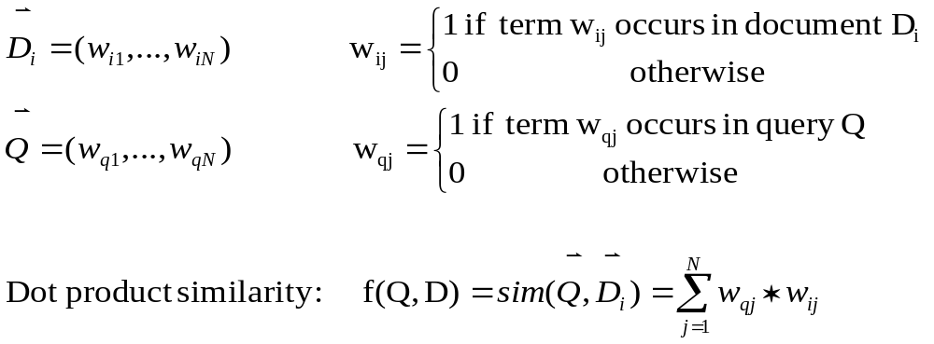
Simplest Instantiation:
0-1 bit vector + dot product similarity
Vocabulary V={w₁, w₂, …, w_{N}} ➔ N-dimensional space
Query Q = q₁,…,q_{m,} (q_{i} ∈ V) ➔ {0,1} bit vector
Document D_{i} = d_{i1},…,d_{imi,} (d_{ij} ∈ V) ➔ {0,1} bit vector
Ranking function: f(Q, D) ➔ dot-product(Q,D) ∈ℜ
What does this ranking function intuitively capture?
Is this good enough? Possible improvements?
MIAS Tutorial Summer 2012

Slide 35
An Example: how do we want the documents to be ranked?
Query = “news about presidential campaign”
D1
… news about …
D2
… news about organic food campaign…
D3
… news of presidential campaign …
D4
… news of presidential campaign …
… presidential candidate …
D5
… news of organic food campaign… campaign…campaign…campaign…
MIAS Tutorial Summer 2012

Slide 36
Ranking by the Simplest VS Model
V= {news about presidential camp. food …. }
Query = “news about presidential campaign”
Q= (1, 1, 1, 1, 0, 0, …)
D1
… news about …
D1= (1, 1, 0, 0, 0, 0, …) Sim(D1,Q)=1*1+1*1=2
D2
… news about organic food campaign…
D2= (1, 1, 0, 1, 1, 0, …) Sim(D2,Q)=1*1+1*1+1*1=3
D3
… news of presidential campaign …
D3= (1, 0, 1, 1, 0, 0, …) Sim(D3,Q)=1*1+1*1+1*1=3
D4
… news of presidential campaign …
… presidential candidate …
D4= (1, 0, 1, 1, 0, 0, …) Sim(D4,Q)=1*1+1*1+1*1=3
D5
… news of organic food campaign… campaign…campaign…campaign…
D5= (1, 0, 0, 1, 1, 0, …) Sim(D5,Q)=1*1+1*1=2
MIAS Tutorial Summer 2012

Slide 37
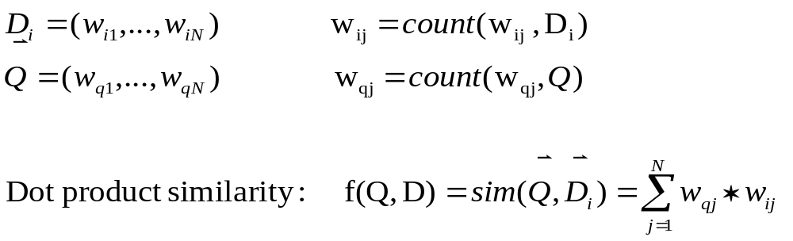
Improved Instantiation : frequency vector + dot product similarity
Vocabulary V={w₁, w₂, …, w_{N}} ➔ N-dimensional space
Query Q = q₁,…,q_{m,} (q_{i} ∈ V) ➔ term frequency vector
Document D_{i} = d_{i1},…,d_{imi,} (d_{ij} ∈ V) ➔ term frequency vector
Ranking function: f(Q, D) ➔ dot-product(Q,D) ∈ℜ
What does this ranking function intuitively capture?
Is this good enough? Possible improvements?
MIAS Tutorial Summer 2012

Slide 38
Ranking by the Improved VS Model
V= {news about presidential camp. food …. }
Query = “news about presidential campaign”
Q= (1, 1, 1, 1, 0, 0, …)
D1
… news about …
D1= (1, 1, 0, 0, 0, 0, …) Sim(D1,Q)=1*1+1*1=2
D2
… news about organic food campaign…
D2= (1, 1, 0, 1, 1, 0, …) Sim(D2,Q)=1*1+1*1+1*1=3(?)
D3
… news of presidential campaign …
D3= (1, 0, 1, 1, 0, 0, …) Sim(D3,Q)=1*1+1*1+1*1=3(?)
D4
… news of presidential campaign …
… presidential candidate …
D4= (1, 0, 2, 1, 0, 0, …) Sim(D4,Q)=1*1+2*1+1*1=4
D5
… news of organic food campaign… campaign…campaign…campaign…
D5= (1, 0, 0, 4, 1, 0, …) Sim(D5,Q)=1*1+1*4=5(?)
MIAS Tutorial Summer 2012

Slide 39
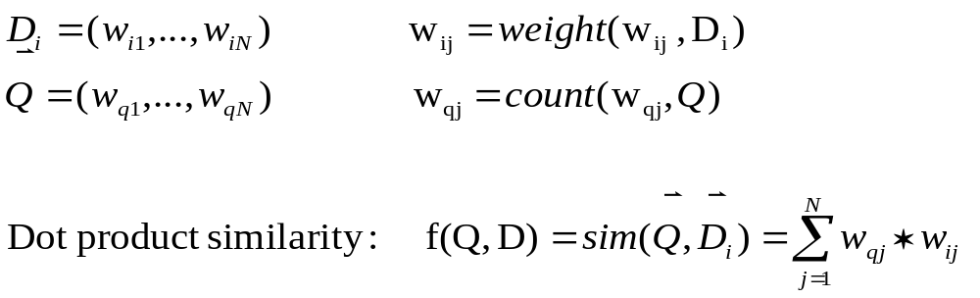
Further Improvement: weighted term vector + dot product
Vocabulary V={w₁, w₂, …, w_{N}} ➔ N-dimensional space
Query Q = q₁,…,q_{m,} (q_{i} ∈ V) ➔ term frequency vector
Document D_{i} = d_{i1},…,d_{imi,} (d_{ij} ∈ V) ➔ weighted term vector
Ranking function: f(Q, D) ➔ dot-product(Q,D) ∈ℜ
How do we design an optimal weighting function?
How do we “upper-bound” term frequency?
How do we penalize common terms?
MIAS Tutorial Summer 2012

Slide 40
In general, VS Model only provides a framework for designing a ranking function
We’ll need to further define
1. the concept space
2. weighting function
3. similarity function
MIAS Tutorial Summer 2012

Slide 41
What’s a good “basic concept”?
Orthogonal
  Linearly independent basis vectors
  “Non-overlapping” in meaning
No ambiguity
Weights can be assigned automatically and hopefully accurately
Many possibilities: Words, stemmed words, phrases, “latent concept”, …
MIAS Tutorial Summer 2012

Slide 42
How to Assign Weights?
Very very important!
Why weighting
  Query side: Not all terms are equally important
  Doc side: Some terms carry more information about contents
How?
  Two basic heuristics
    TF (Term Frequency) = Within-doc-frequency
    IDF (Inverse Document Frequency)
  TF normalization
MIAS Tutorial Summer 2012

Slide 43
TF Weighting
Idea: A term is more important if it occurs more frequently in a document
Formulas: Let c(t,d) be the frequency count of term t in doc d
  Raw TF: TF(t,d) = c(t,d)
  Log TF: TF(t,d)=log ( c(t,d) +1)
  Maximum frequency normalization: TF(t,d) = 0.5 +0.5*c(t,d)/MaxFreq(d)
  “Okapi/BM25 TF”: TF(t,d) = (k+1) c(t,d)/(c(t,d)+k(1-b+b*doclen/avgdoclen))
Normalization of TF is very important!
MIAS Tutorial Summer 2012

Slide 44
TF Normalization
Why?
  Document length variation
  “Repeated occurrences” are less informative than the “first occurrence”
Two views of document length
  A doc is long because it uses more words
  A doc is long because it has more contents
Generally penalize long doc, but avoid over-penalizing (pivoted normalization)
MIAS Tutorial Summer 2012

Slide 45
TF Normalization (cont.)
Norm. TF
Raw TF
“Pivoted normalization”: Using avg. doc length to regularize normalization
1-b+b*doclen/avgdoclen
b varies from 0 to 1
Normalization interacts with the similarity measure
MIAS Tutorial Summer 2012

Slide 46
IDF Weighting
Idea: A term is more discriminative/important if it occurs only in fewer documents
Formula: IDF(t) = 1+ log(n/k) n – total number of docs k -- # docs with term t (doc freq)
Other variants:
  IDF(t) = log((n+1)/k)
  IDF(t)=log ((n+1)/(k+0.5))
What are the maximum and minimum values of IDF?
MIAS Tutorial Summer 2012

Slide 47
Non-Linear Transformation in IDF
IDF(t)
IDF(t) = 1+ log(n/k)
1+log(n)
Linear penalization
k (doc freq)
1
N
=totoal number of docs in collection
Is this transformation optimal?
MIAS Tutorial Summer 2012

Slide 48
TF-IDF Weighting
TF-IDF weighting : weight(t,d)=TF(t,d)*IDF(t)
  Common in doc → high tf → high weight
  Rare in collection→ high idf→ high weight
Imagine a word count profile, what kind of terms would have high weights?
MIAS Tutorial Summer 2012

Slide 49
Empirical distribution of words
There are stable language-independent patterns in how people use natural languages
A few words occur very frequently; most occur rarely. E.g., in news articles,
  Top 4 words: 10~15% word occurrences
  Top 50 words: 35~40% word occurrences
The most frequent word in one corpus may be rare in another
MIAS Tutorial Summer 2012

Slide 50
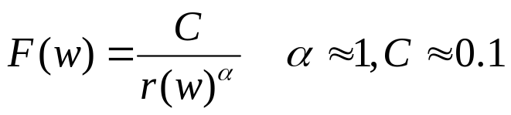
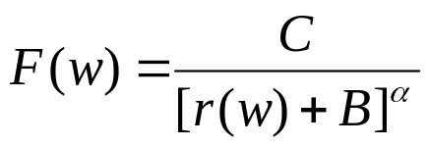
Zipf’s Law
rank * frequency ≈ constant
Word
Freq.
Most useful words
Biggest
data structure
(stop words)
Is “too rare” a problem?
Word Rank (by Freq)
Generalized Zipf’s law:
Applicable in many domains
MIAS Tutorial Summer 2012

Slide 51
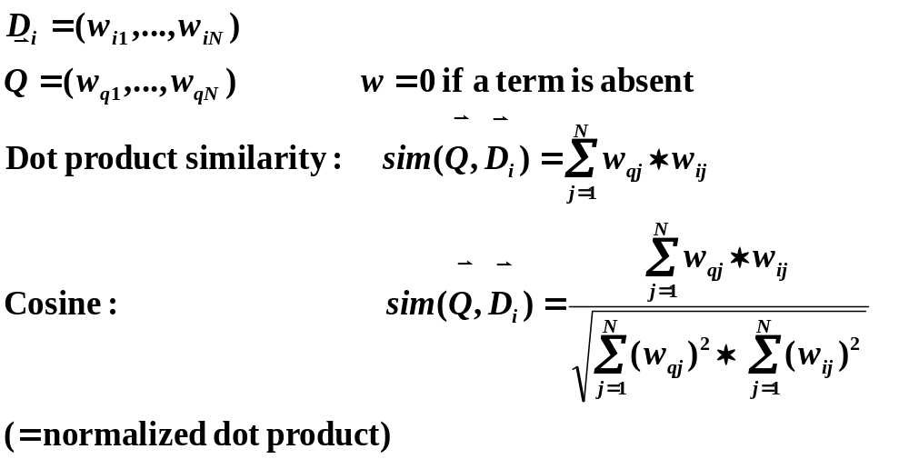
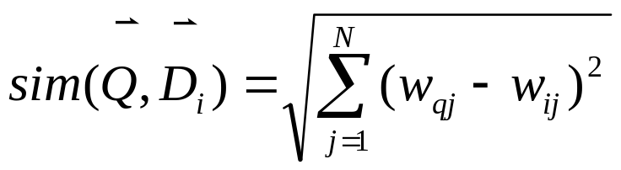
How to Measure Similarity?
How about Euclidean?
MIAS Tutorial Summer 2012

Slide 52
VS Example: Raw TF & Dot Product
information
retrieval
search
engine
information
doc1
Sim(q,doc1)=2*2.4*1+1*4.5*1
Sim(q,doc2)=1*2.4*1
Sim(q,doc3)=0
query=“information retrieval”
travel
information
map
travel
How to do this quickly?
More about this later…
doc2
info retrieval travel map search engine govern president congress
IDF 2.4 4.5 2.8 3.3 2.1 5.4 2.2 3.2 4.3
doc1 2 1 1 1
doc2 1 2 1
doc3 1 1 1
query 1 1
query*IDF 2.4 4.5
government
president
congress
doc3
……
MIAS Tutorial Summer 2012

Slide 53
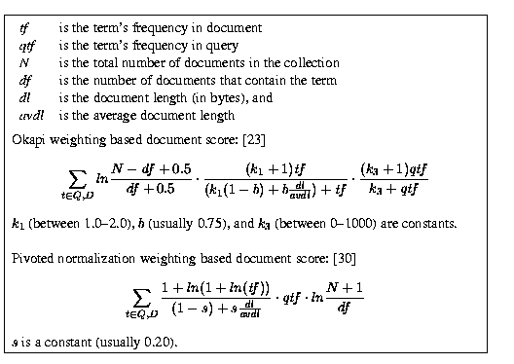
What Works the Best?
Use single words
Use stat. phrases
Remove stop words
Stemming (?)
Error
[ ]
(Singhal 2001)
MIAS Tutorial Summer 2012

Slide 54
Advantages of VS Model
Empirically effective
Intuitive
Easy to implement
Warning: Many variants of TF-IDF!
MIAS Tutorial Summer 2012

Slide 55
Disadvantages of VS Model
Assume term independence
Assume query and document to be the same
Lack of “predictive adequacy”
  Arbitrary term weighting
  Arbitrary similarity measure
Ad hoc parameter tuning
MIAS Tutorial Summer 2012

Slide 56
Model 2: Language Models
MIAS Tutorial Summer 2012

Slide 57
Many Different Retrieval Models
Similarity-based models:
  a document that is more similar to a query is assumed to be more likely relevant to the query
  relevance (d,q) = similarity (d,q)
  e.g., Vector Space Model
Probabilistic models (language models):
  compute the probability that a given document is relevant to a query based on a probabilistic model
  relevance(d,q) = p(R=1|d,q), where R ∈{0,1} is a binary random variable
  E.g., Query Likelihood
MIAS Tutorial Summer 2012

Slide 58
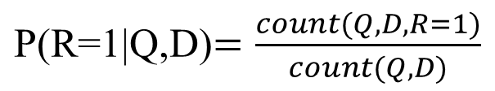
Probabilistic Retrieval Models: Intuitions
Suppose we have a large number of relevance judgments
(e.g., clickthroughs: “1”=clicked; “0”= skipped)
We can score documents based on
Query(Q) Doc (D) Rel (R) ?
Q1 D1 1
Q1 D2 1
Q1 D3 0
Q1 D4 0
Q1 D5 1
…
Q1 D1 0
Q1 D2 1
Q1 D3 0
Q2 D3 1
Q3 D1 1
Q4 D2 1
Q4 D3 0
…
P(R=1|Q1, D1)=1/2
P(R=1|Q1,D2)=2/2
P(R=1|Q1,D3)=0/2
…
What if we don’t have (sufficient) search log?
We can approximate p(R=1|Q,D)
Query Likelihood is one way to approximate
P(R=1|Q,D) ➔ p(Q|D,R=1)
If a user liked document D, how likely Q
is the query entered by the user?
MIAS Tutorial Summer 2012

Slide 59
What is a Statistical LM?
A probability distribution over word sequences
  p(“Today is Wednesday”) ≈ 0.001
  p(“Today Wednesday is”) ≈ 0.0000000000001
  p(“The eigenvalue is positive”) ≈ 0.00001
Context/topic dependent!
Can also be regarded as a probabilistic mechanism for “generating” text, thus also called a “generative” model
MIAS Tutorial Summer 2012

Slide 60
The Simplest Language Model
(Unigram Model)
Generate a piece of text by generating each word independently
Thus, p(w₁ w₂ ... w_{n})=p(w₁)p(w₂)…p(w_{n})
Parameters: {p(w_{i})} p(w₁)+…+p(w_{N})=1 (N is voc. size)
Essentially a multinomial distribution over words
A piece of text can be regarded as a sample drawn according to this word distribution
MIAS Tutorial Summer 2012

Slide 61
Text Generation with Unigram LM
(Unigram) Language Model θ
p(w| θ)
Sampling
Document
…
text 0.2
mining 0.1
association 0.01
clustering 0.02
…
food 0.00001
…
Text mining
paper
Topic 1:
Text mining
…
food 0.25
nutrition 0.1
healthy 0.05
diet 0.02
…
Topic 2:
Health
Food nutrition
paper
MIAS Tutorial Summer 2012

Slide 62
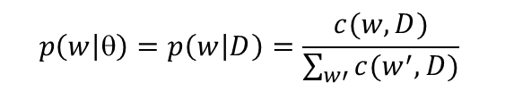
Estimation of Unigram LM
(Unigram) Language Model θ
p(w| θ)=?
Estimation
Document
…
text ?
mining ?
association ?
database ?
…
query ?
…
text 10
mining 5
association 3
database 3
algorithm 2
…
query 1
efficient 1
10/100
5/100
3/100
3/100
1/100
Maximum Likelihood (ML) Estimator:
(maximizing the probability of observing document D)
A “text mining paper”
(total #words=100)
Is this our best guess of parameters? More about this later…
MIAS Tutorial Summer 2012

Slide 63
More Sophisticated LMs
N-gram language models
  In general, p(w₁ w₂ ... w_{n})=p(w₁)p(w₂|w₁)…p(w_{n}|w₁ …w_{n-1})
  n-gram: conditioned only on the past n-1 words
  E.g., bigram: p(w₁ ... w_{n})=p(w₁)p(w₂|w₁) p(w₃|w₂) …p(w_{n}|w_{n-1})
Remote-dependence language models (e.g., Maximum Entropy model)
Structured language models (e.g., probabilistic context-free grammar)
Will not be covered in detail in this tutorial. If interested, read [Manning & Schutze 99]
MIAS Tutorial Summer 2012

Slide 64
Why Just Unigram Models?
Difficulty in moving toward more complex models
  They involve more parameters, so need more data to estimate (A doc is an extremely small sample)
  They increase the computational complexity significantly, both in time and space
Capturing word order or structure may not add so much value for “topical inference”
But, using more sophisticated models can still be expected to improve performance ...
MIAS Tutorial Summer 2012

Slide 65
Language Models for Retrieval:
Query Likelihood Retrieval Model
Language Model
Document
P(“data mining alg”|D1)
=p(“data”|D1)p(“mining”|D1)p(“alg”|D1)
D1
…
text ?
mining ?
assocation ?
clustering ?
…
food ?
…
Query =
“data mining algorithms”
Text mining
paper
?
Which model would most
likely have generated
this query?
D2
…
food ?
nutrition ?
healthy ?
diet ?
…
Food nutrition
paper
P(“data mining alg”|D2)
=p(“data”|D2)p(“mining”|D2)p(“alg”|D2)
MIAS Tutorial Summer 2012

Slide 66
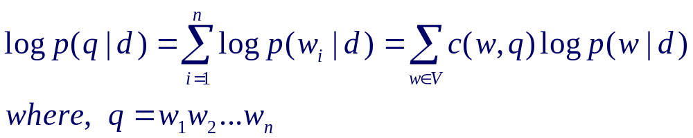
Retrieval as
Language Model Estimation
Document ranking based on query likelihood (=log-query likelihood)
Document language model
Retrieval problem ≈ Estimation of p(w_{i}|d)
Smoothing is an important issue, and distinguishes different approaches
MIAS Tutorial Summer 2012

Slide 67
How to Estimate p(w|d)?
Simplest solution: Maximum Likelihood Estimator
  P(w|d) = relative frequency of word w in d
  What if a word doesn’t appear in the text? P(w|d)=0
In general, what probability should we give a word that has not been observed?
If we want to assign non-zero probabilities to such words, we’ll have to discount the probabilities of observed words
This is what “smoothing” is about …
MIAS Tutorial Summer 2012

Slide 68
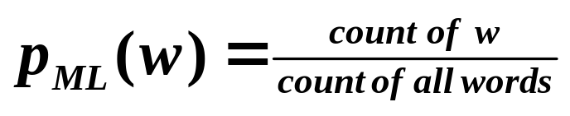
Language Model Smoothing (Illustration)
P(w)
Max. Likelihood Estimate
Smoothed LM
Word w
MIAS Tutorial Summer 2012

Slide 69
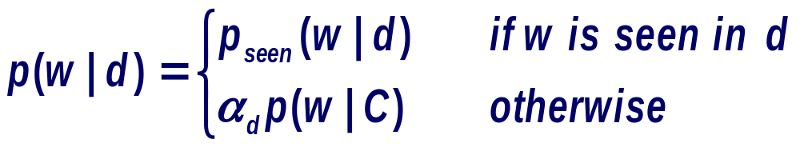
A General Smoothing Scheme
All smoothing methods try to
  discount the probability of words seen in a doc
  re-allocate the extra probability so that unseen words will have a non-zero probability
Most use a reference model (collection language model) to discriminate unseen words
Discounted ML estimate
Collection language model
MIAS Tutorial Summer 2012

Slide 70
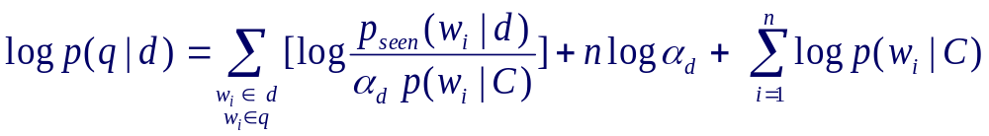
Smoothing & TF-IDF Weighting
Plug in the general smoothing scheme to the query likelihood retrieval formula, we obtain
Doc length normalization
(long doc is expected to have a smaller α_{d})
TF weighting
IDF weighting
Ignore for ranking
Smoothing with p(w|C) ≈ TF-IDF + length norm.
MIAS Tutorial Summer 2012

Slide 71
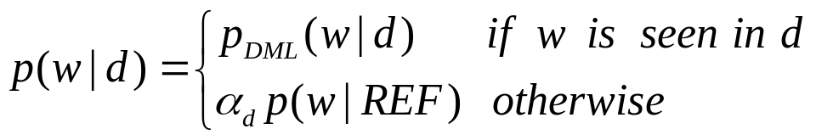
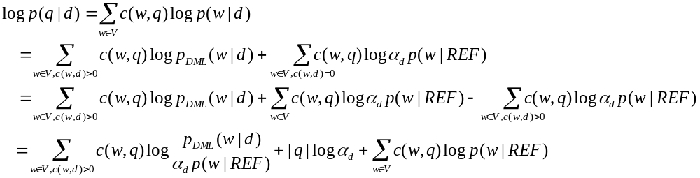
Derivation of Query Likelihood
The general smoothing scheme
Retrieval formula using the general smoothing scheme
Discounted ML estimate
Reference language model
The key rewriting step
Similar rewritings are very common when using LMs for IR…
MIAS Tutorial Summer 2012

Slide 72
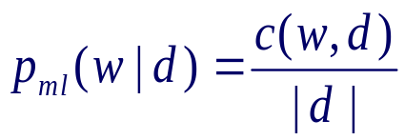
Two Smoothing Methods
Linear Interpolation (Jelinek-Mercer): Shrink uniformly toward p(w|C)
Dirichlet prior (Bayesian): Assume pseudo counts μp(w|C)
Special case: p(w|C)=1/|V| is uniform and µ=|V| ➔ Add “1” smoothing
(also called Laplace smoothing)
MIAS Tutorial Summer 2012

Slide 73


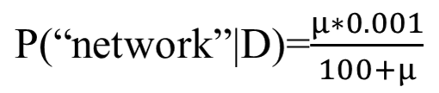
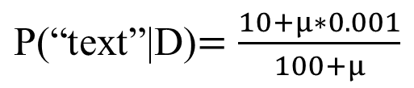
Smoothing with Collection Model
(Unigram) Language Model θ
p(w| θ)=?
Estimation
Collection LM
P(w|C)
Document
…
text ?
mining ?
association ?
database ?
…
query ?
…
network?
text 10
mining 5
association 3
database 3
algorithm 2
…
query 1
efficient 1
the 0.1
a 0.08
..
computer 0.02
database 0.01
……
text 0.001
network 0.001
mining 0.0009
…
10/100
5/100
3/100
3/100
1/100
0/100
Jelinek-Mercer
(total #words=100)
Dirichlet prior
MIAS Tutorial Summer 2012

Slide 74
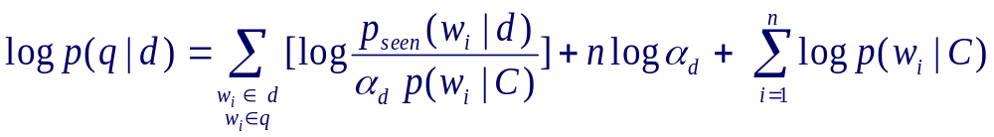
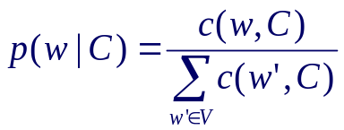
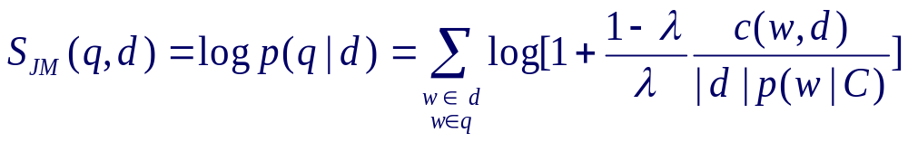
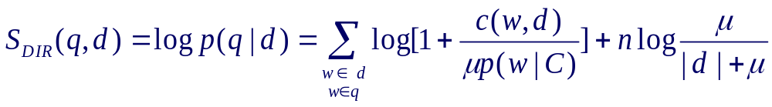
Query Likelihood Retrieval Functions
With Jelinek-Mercer (JM):
With Dirichlet Prior (DIR):
What assumptions have we made in order to derive these functions?
Do they capture the same retrieval heuristics (TF-IDF, Length Norm)
as a vector space retrieval function?
MIAS Tutorial Summer 2012

Slide 75
Pros & Cons of
Language Models for IR
Pros
  Grounded on statistical models; formulas dictated by the assumed model
  More meaningful parameters that can potentially be estimated based on data
  Assumptions are explicit and clear
Cons
  May not work well empirically (non-optimal modeling of relevance)
  Not always easy to inject heuristics
MIAS Tutorial Summer 2012

Slide 76
Feedback in Information Retrieval
MIAS Tutorial Summer 2012

Slide 77
Relevance Feedback
Users make explicit relevance judgments on the initial results
(judgments are reliable, but users don’t want to make extra effort)
Results:
d₁ 3.5
d₂ 2.4
…
d_{k} 0.5
...
Query
Retrieval
Engine
Updated
query
User
Document
collection
Judgments:
d₁ +
d₂ -
d₃ ₊
…
d_{k} -
...
Feedback
MIAS Tutorial Summer 2012

Slide 78
Pseudo/Blind/Automatic Feedback
Top-k initial results are simply assumed to be relevant
(judgments aren’t reliable, but no user activity is required)
Results:
d₁ 3.5
d₂ 2.4
…
d_{k} 0.5
...
Query
Retrieval
Engine
Updated
query
Document
collection
Judgments:
d₁ +
d₂ +
d₃ ₊
…
d_{k} -
...
top 10
assumed
relevant
Feedback
MIAS Tutorial Summer 2012

Slide 79
Implicit Feedback
User-clicked docs are assumed to be relevant; skipped ones non-relevant
(judgments aren’t completely reliable, but no extra effort from users)
Results:
d₁ 3.5
d₂ 2.4
…
d_{k} 0.5
...
Query
Retrieval
Engine
Updated
query
User
Document
collection
Clickthroughs:
d₁ +
d₂ -
d₃ ₊
…
d_{k} -
...
Feedback
MIAS Tutorial Summer 2012

Slide 80
Relevance Feedback in VS
Basic setting: Learn from examples
  Positive examples: docs known to be relevant
  Negative examples: docs known to be non-relevant
  How do you learn from this to improve performance?
General method: Query modification
  Adding new (weighted) terms
  Adjusting weights of old terms
  Doing both
The most well-known and effective approach is Rocchio
MIAS Tutorial Summer 2012

Slide 81
Rocchio Feedback: Illustration
Centroid of
non-relevant documents
Centroid of relevant documents
-
-
-
+
-
-
-
+
+
-
-
+
+
-
-
-
-
+
q
-
q_{m}
-
+
+
+
-
-
+
+
-
-
+
+
+
+
+
-
+
+
+
-
-
-
-
-
-
-
-
MIAS Tutorial Summer 2012

Slide 82
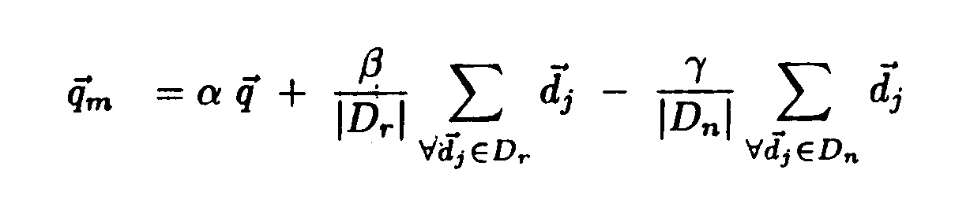
Rocchio Feedback: Formula
Parameters
New query
Origial query
Rel docs
Non-rel docs
MIAS Tutorial Summer 2012

Slide 83
Example of Rocchio Feedback
V= {news about presidential camp. food …. }
Query = “news about presidential campaign”
Q= (1, 1, 1, 1, 0, 0, …)
D1
New Query Q’= (α*1+β*1.5-γ*1.5, α*1-γ*0.067, α*1+β*3.5, α*1+β*2.0-γ*2.6, -γ*1.3, 0, 0, …)
… news about …
- D1= (1.5, 0.1, 0, 0, 0, 0, …)
D2
… news about organic food campaign…
- D2= (1.5, 0.1, 0, 2.0, 2.0, 0, …)
D3
… news of presidential campaign …
+ D3= (1.5, 0, 3.0, 2.0, 0, 0, …)
D4
… news of presidential campaign …
… presidential candidate …
+ Centroid Vector= ((1.5+1.5)/2, 0, (3.0+4.0)/2, (2.0+2.0)/2, 0, 0, …)
=(1.5 , 0, 3.5, 2.0, 0, 0,…)
+ D4= (1.5, 0, 4.0, 2.0, 0, 0, …)
D5
- Centroid Vector= ((1.5+1.5+1.5)/3, (0.1+0.1+0)/3, 0, (0+2.0+6.0)/3, (0+2.0+2.0)/3, 0, …)
=(1.5 , 0.067, 0, 2.6, 1.3, 0,…)
… news of organic food campaign… campaign…campaign…campaign…
- D5= (1.5, 0, 0, 6.0, 2.0, 0, …)
MIAS Tutorial Summer 2012

Slide 84
Rocchio in Practice
Negative (non-relevant) examples are not very important (why?)
Often truncate the vector (i.e., consider only a small number of words that have highest weights in the centroid vector) (efficiency concern)
Avoid “over-fitting” (keep relatively high weight on the original query weights) (why?)
Can be used for relevance feedback and pseudo feedback (β should be set to a larger value for relevance feedback than for pseudo feedback)
Usually robust and effective
MIAS Tutorial Summer 2012

Slide 85
Feedback with Language Models
Query likelihood method can’t naturally support feedback
Solution:
  Kullback-Leibler (KL) divergence retrieval model as a generalization of query likelihood
  Feedback is achieved through query model estimation/updating
MIAS Tutorial Summer 2012

Slide 86
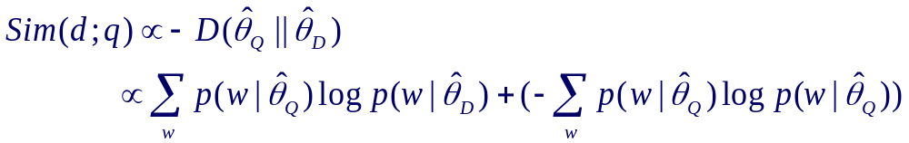
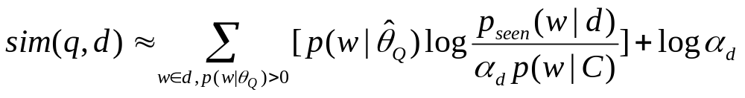

Kullback-Leibler (KL) Divergence Retrieval Model
Unigram similarity model
Retrieval ≈ Estimation of θ_{Q} and θ_{D}
Special case: = empirical distribution of q recovers “query-likelihood”
query entropy
(ignored for ranking)
MIAS Tutorial Summer 2012

Slide 87







Feedback as Model Interpolation
Document D
Results
Query Q
Feedback Docs
F={d₁, d₂ , …, d_{n}}
α=0
α=1
Generative model
No feedback
Full feedback
MIAS Tutorial Summer 2012

Slide 88
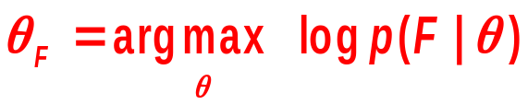
Generative Mixture Model
Background words
λ
P(w| C)
w
P(source)
F={d₁, …, d_{n}}
Topic words
1-λ
P(w| θ )
w
Maximum Likelihood
λ = Noise in feedback documents
MIAS Tutorial Summer 2012

Slide 89
Understanding a Mixture Model
the 0.2
a 0.1
we 0.01
to 0.02
…
text 0.0001
mining 0.00005
…
Suppose each model would be selected with
equal probability λ=0.5
Known
Background
p(w|C)
The probability of observing word “text”:
λp(“text”|C) + (1- λ)p(“text”| θ_{F})
=0.5*0.0001 + 0.5* p(“text”| θ_{F})
The probability of observing word “the”:
λp(“the”|C) + (1- λ)p(“the”| θ_{F})
=0.5*0.2 + 0.5* p(“the”| θ_{F})
Unknown
query topic
p(w|θ_{F})=?
“Text mining”
…
text =?
mining =?
association =?
word =?
…
The probability of observing “the” & “text”
(likelihood)
[0.5*0.0001 + 0.5* p(“text”| θ_{F})]
× [0.5*0.2 + 0.5* p(“the”| θ_{F})]
How to set p(“the”| θ_{F}) and p(“text”| θ_{F}) so as to maximize this likelihood?
assume p(“the”| θ_{F})+p(“text”| θ_{F})=constant
➔ give p(“text”| θ_{F}) a higher probability than p(“the”| θ_{F}) (why?)
MIAS Tutorial Summer 2012

Slide 90
How to Estimate θ_{F}?
the 0.2
a 0.1
we 0.01
to 0.02
…
text 0.0001
mining 0.00005
…
Observed
Doc(s)
Known
Background
p(w|C)
λ=0.7
ML
Estimator
Unknown
query topic
p(w|θ_{F})=?
“Text mining”
…
text =?
mining =?
association =?
word =?
…
λ=0.3
Suppose,
we know
the identity of each word ...
MIAS Tutorial Summer 2012

Slide 91
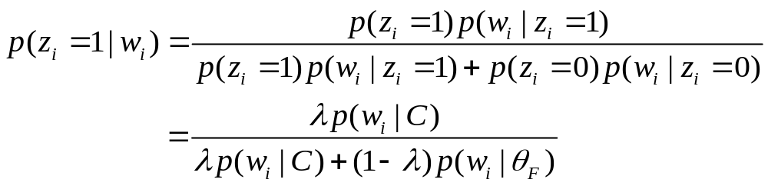
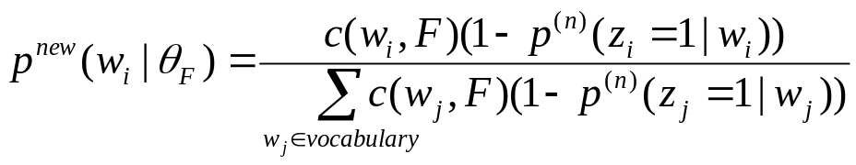
Can We Guess the Identity?
Identity (“hidden”) variable: z_{i} ∈{1 (background), 0(topic)}
z_{i}
1
1
1
1
0
0
0
1
0
...
Suppose the parameters are all known, what’s a reasonable guess of z_{i}?
- depends on λ (why?)
- depends on p(w|C) and p(w|θ_{F}) (how?)
the
paper
presents
a
text
mining
algorithm
the
paper
...
E-step
M-step
Initially, set p(w| θ_{F}) to some random value, then iterate …
MIAS Tutorial Summer 2012

Slide 92
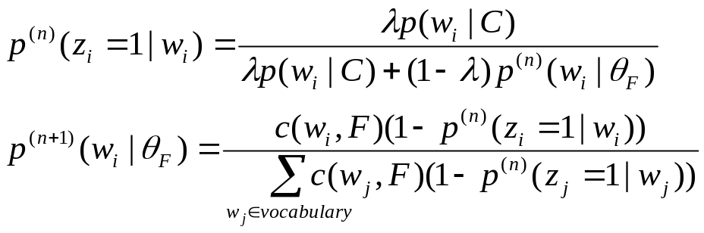
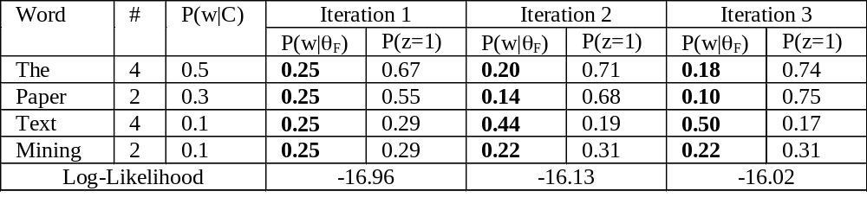
An Example of EM Computation
Expectation-Step:
Augmenting data by guessing hidden variables
Maximization-Step
With the “augmented data”, estimate parameters
using maximum likelihood
Assume λ=0.5
MIAS Tutorial Summer 2012

Slide 93
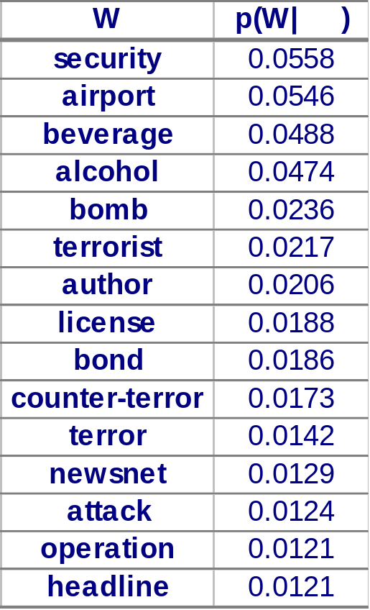

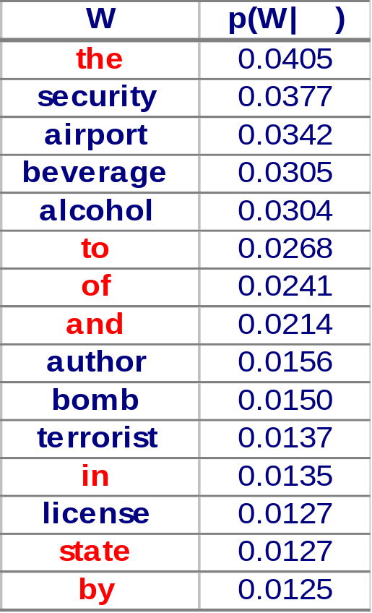
Example of Feedback Query Model
Trec topic 412: “airport security”
λ=0.9
Mixture model approach
Web database
Top 10 docs
λ=0.7
MIAS Tutorial Summer 2012

Slide 94
Part 2.3 Evaluation in Information Retrieval
MIAS Tutorial Summer 2012

Slide 95
Why Evaluation?
Reason 1: So that we can assess how useful an IR system/technology would be (for an application)
  Measures should reflect the utility to users in a real application
  Usually done through user studies (interactive IR evaluation)
Reason 2: So that we can compare different systems and methods (to advance the state of the art)
  Measures only need to be correlated with the utility to actual users, thus don’t have to accurately reflect the exact utility to users
  Usually done through test collections (test set IR evaluation)
MIAS Tutorial Summer 2012

Slide 96
What to Measure?
Effectiveness/Accuracy: how accurate are the search results?
  Measuring a system’s ability of ranking relevant docucments on top of non-relevant ones
Efficiency: how quickly can a user get the results? How much computing resources are needed to answer a query?
  Measuring space and time overhead
Usability: How useful is the system for real user tasks?
  Doing user studies
MIAS Tutorial Summer 2012

Slide 97
The Cranfield Evaluation Methodology
A methodology for laboratory testing of system components developed in 1960s
Idea: Build reusable test collections & define measures
  A sample collection of documents (simulate real document collection)
  A sample set of queries/topics (simulate user queries)
  Relevance judgments (ideally made by users who formulated the queries) ➔ Ideal ranked list
  Measures to quantify how well a system’s result matches the ideal ranked list
A test collection can then be reused many times to compare different systems
MIAS Tutorial Summer 2012

Slide 98
Test Collection Evaluation
Queries
Relevance
Judgments
Query= Q1
Q1 Q2 Q3
… Q50 ...
Q1 D1 +
Q1 D2 +
Q1 D3 –
Q1 D4 –
Q1 D5 +
…
Q2 D1 –
Q2 D2 +
Q2 D3 +
Q2 D4 –
…
Q50 D1 –
Q50 D2 –
Q50 D3 +
…
D2 +
D1 +
D4 -
D5 +
Precision=3/4
Recall=3/3
System A
D2
D1 +
D4 -
D3 -
D5 +
System B
Precision=2/4
Recall=2/3
D1
D3
…
D48
Document Collection
MIAS Tutorial Summer 2012

Slide 99
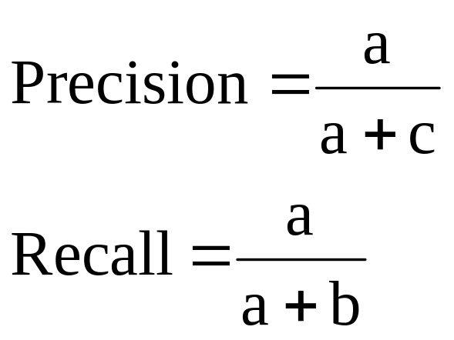
Measures for evaluating a set of retrieved documents
Action
Retrieved
Not Retrieved
Doc
Relevant
Relevant Retrieved
a
Relevant Rejected
b
Not relevant
Irrelevant Retrieved
c
Irrelevant Rejected
d
Ideal results: Precision=Recall=1.0
In reality, high recall tends to be
associated with low precision (why?)
MIAS Tutorial Summer 2012

Slide 100
How to measure a ranking?
Compute the precision at every recall point
Plot a precision-recall (PR) curve
Which is better?
precision
x
precision
x
x
x
x
x
x
x
recall
recall
MIAS Tutorial Summer 2012

Slide 101
Summarize a Ranking: MAP
Given that n docs are retrieved
  Compute the precision (at rank) where each (new) relevant document is retrieved => p(1),…,p(k), if we have k rel. docs
  E.g., if the first rel. doc is at the 2nd rank, then p(1)=1/2.
  If a relevant document never gets retrieved, we assume the precision corresponding to that rel. doc to be zero
Compute the average over all the relevant documents
  Average precision = (p(1)+…p(k))/k
This gives us an average precision, which captures both precision and recall and is sensitive to the rank of each relevant document
Mean Average Precisions (MAP)
  MAP = arithmetic mean average precision over a set of topics
  gMAP = geometric mean average precision over a set of topics (more affected by difficult topics)
MIAS Tutorial Summer 2012

Slide 102
Summarize a Ranking: NDCG
What if relevance judgments are in a scale of [1,r]? r>2
Cumulative Gain (CG) at rank n
  Let the ratings of the n documents be r1, r2, …rn (in ranked order)
  CG = r1+r2+…rn
Discounted Cumulative Gain (DCG) at rank n
  DCG = r1 + r2/log₂2 + r3/log₂3 + … rn/log₂n
  We may use any base for the logarithm, e.g., base=b
  For rank positions above b, do not discount
Normalized Cumulative Gain (NDCG) at rank n
  Normalize DCG at rank n by the DCG value at rank n of the ideal ranking
  The ideal ranking would first return the documents with the highest relevance level, then the next highest relevance level, etc
MIAS Tutorial Summer 2012

Slide 103
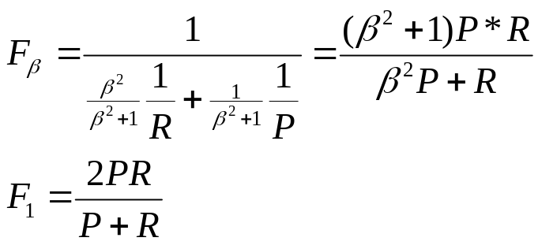
Other Measures
Precision at k documents (e.g., prec@10doc):
  more meaningful to a user than MAP (why?)
  also called breakeven precision when k is the same as the number of relevant documents
Mean Reciprocal Rank (MRR):
  Same as MAP when there’s only 1 relevant document
  Reciprocal Rank = 1/Rank-of-the-relevant-doc
F-Measure (F1): harmonic mean of precision and recall
P: precision
R: recall
β: parameter
(often set to 1)
MIAS Tutorial Summer 2012

Slide 104
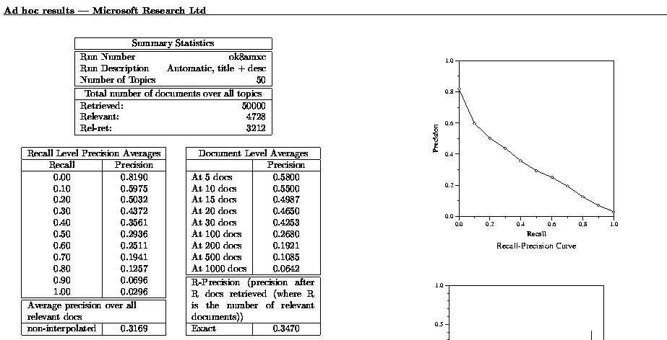
Typical TREC Evaluation Result
Precion-Recall Curve
Out of 4728 rel docs,
we’ve got 3212
Recall=3212/4728
Precision@10docs
about 5.5 docs
in the top 10 docs
are relevant
Breakeven Precision
(precision when prec=recall)
D1 +
D2 +
D3 –
D4 –
D5 +
D6 -
Mean Avg. Precision (MAP)
Total # rel docs = 4
System returns 6 docs
Average Prec = (1/1+2/2+3/5+0)/4
Denominator is 4, not 3 (why?)
MIAS Tutorial Summer 2012

Slide 105
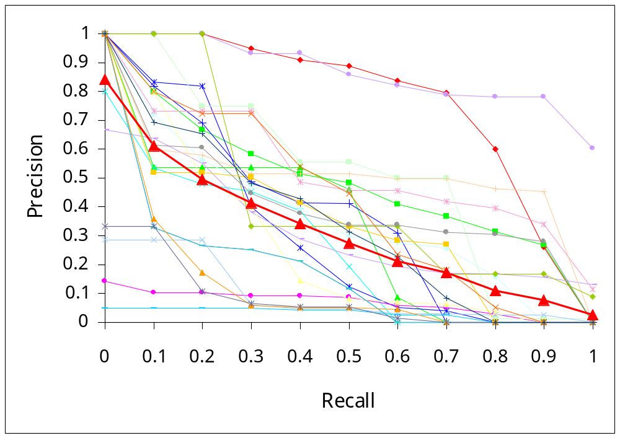
What Query Averaging Hides
Slide from Doug Oard’s presentation, originally from Ellen Voorhees’ presentation
MIAS Tutorial Summer 2012

Slide 106
Statistical Significance Tests
How sure can you be that an observed difference doesn’t simply result from the particular queries you chose?
Experiment 1
Experiment 2
Query
System A
System B
Query
System A
System B
1
2
3
4
5
6
7
0.20
0.21
0.22
0.19
0.17
0.20
0.21
0.40
0.41
0.42
0.39
0.37
0.40
0.41
1
2
3
4
5
6
7
0.02
0.39
0.16
0.58
0.04
0.09
0.12
0.76
0.07
0.37
0.21
0.02
0.91
0.46
Average
0.20
0.40
Average
0.20
0.40
Slide from Doug Oard
MIAS Tutorial Summer 2012

Slide 107
Statistical Significance Testing
Query
System A
System B
Sign Test
Wilcoxon
1
2
3
4
5
6
7
0.02
0.39
0.16
0.58
0.04
0.09
0.12
0.76
0.07
0.37
0.21
0.02
0.91
0.46
+
-
+
-
-
+
-
+0.74
- 0.32
+0.21
- 0.37
- 0.02
+0.82
- 0.38
Average
0.20
0.40
p=1.0
p=0.9375
95% of outcomes
0
Slide from Doug Oard
MIAS Tutorial Summer 2012

Slide 108
Part 2.4 Information Retrieval Systems
MIAS Tutorial Summer 2012

Slide 109
IR System Architecture
docs
INDEXING
Doc
Rep
Query
Rep
query
User
Ranking
SEARCHING
results
INTERFACE
Feedback
judgments
QUERY MODIFICATION
MIAS Tutorial Summer 2012

Slide 110
Indexing
Indexing = Convert documents to data structures that enable fast search
Inverted index is the dominating indexing method (used by all search engines)
Other indices (e.g., document index) may be needed for feedback
MIAS Tutorial Summer 2012

Slide 111
Inverted Index
Fast access to all docs containing a given term (along with freq and pos information)
For each term, we get a list of tuples (docID, freq, pos).
Given a query, we can fetch the lists for all query terms and work on the involved documents.
  Boolean query: set operation
  Natural language query: term weight summing
More efficient than scanning docs (why?)
MIAS Tutorial Summer 2012

Slide 112
Inverted Index Example
Doc 1
Dictionary
Postings
This is a sample
document
with one sample
sentence
Term | # docs | Total freq
This | 2 | 2
is | 2 | 2
sample | 2 | 3
another | 1 | 1
… | … | …
Doc id | Freq
1 | 1
2 | 1
1 | 1
2 | 1
1 | 2
2 | 1
2 | 1
… | …
… | …
Doc 2
This is another
sample document
MIAS Tutorial Summer 2012

Slide 113
Data Structures for Inverted Index
Dictionary: modest size
  Needs fast random access
  Preferred to be in memory
  Hash table, B-tree, trie, …
Postings: huge
  Sequential access is expected
  Can stay on disk
  May contain docID, term freq., term pos, etc
  Compression is desirable
MIAS Tutorial Summer 2012

Slide 114
Inverted Index Compression
Observations
  Inverted list is sorted (e.g., by docid or termfq)
  Small numbers tend to occur more frequently
Implications
  “d-gap” (store difference): d1, d2-d1, d3-d2-d1,…
  Exploit skewed frequency distribution: fewer bits for small (high frequency) integers
Binary code, unary code, γ-code, δ-code
MIAS Tutorial Summer 2012

Slide 115
Integer Compression Methods
In general, to exploit skewed distribution
Binary: equal-length coding
Unary: x≥1 is coded as x-1 one bits followed by 0, e.g., 3=> 110; 5=>11110
γ-code: x=> unary code for 1+⎣log x⎦ followed by uniform code for x-2 ^{⎣log x⎦} in ⎣log x⎦ bits, e.g., 3=>101, 5=>11001
δ-code: same as γ-code ,but replace the unary prefix with γ-code. E.g., 3=>1001, 5=>10101
MIAS Tutorial Summer 2012

Slide 116
Constructing Inverted Index
The main difficulty is to build a huge index with limited memory
Memory-based methods: not usable for large collections
Sort-based methods:
  Step 1: collect local (termID, docID, freq) tuples
  Step 2: sort local tuples (to make “runs”)
  Step 3: pair-wise merge runs
  Step 4: Output inverted file
MIAS Tutorial Summer 2012

Slide 117
Sort-based Inversion
Sort by doc-id
Sort by term-id
All info about term 1
Term Lexicon:
the 1
cold 2
days 3
a 4
...
doc1
<1,1,3>
<2,1,2>
<3,1,1>
...
<1,2,2>
<3,2,3>
<4,2,2>
…
<1,300,3>
<3,300,1>
...
<1,1,3>
<1,2,2>
<2,1,2>
<2,4,3>
...
<1,5,3>
<1,6,2>
…
<1,299,3>
<1,300,1>
...
<1,1,3>
<1,2,2>
<1,5,2>
<1,6,3>
...
<1,300,3>
<2,1,2>
…
<5000,299,1>
<5000,300,1>
...
doc2
...
DocID
Lexicon:
doc1 1
doc2 2
doc3 3
...
doc300
Parse & Count
“Local” sort
Merge sort
MIAS Tutorial Summer 2012

Slide 118
Searching
Given a query, score documents efficiently
Boolean query
  Fetch the inverted list for all query terms
  Perform set operations to get the subset of docs that satisfy the Boolean condition
  E.g., Q1=“info” AND “security” , Q2=“info” OR “security”
    info: d1, d2, d3, d4
    security: d2, d4, d6
    Results: {d2,d4} (Q1) {d1,d2,d3,d4,d6} (Q2)
MIAS Tutorial Summer 2012

Slide 119
Ranking Documents
Assumption:score(d,q)=f[g(w(d,q,t₁),…w(d,q,t_{n})), w(d),w(q)], where, t_{i}’s are the matched terms
Maintain a score accumulator for each doc to compute function g
For each query term t_{i}
  Fetch the inverted list {(d₁,f₁),…,(d_{n},f_{n})}
  For each entry (d_{j},f_{j}), Compute w(d_{j},q,t_{i}), and Update score accumulator for doc d_{i}
Adjust the score to compute f, and sort
MIAS Tutorial Summer 2012

Slide 120
Ranking Documents: Example
Query = “info security”
S(d,q)=g(t₁)+…+g(t_{n}) [sum of freq of matched terms]
Info: (d1, 3), (d2, 4), (d3, 1), (d4, 5)
Security: (d2, 3), (d4,1), (d5, 3)
Accumulators: d1 d2 d3 d4 d5
0 0 0 0 0
(d1,3) => 3 0 0 0 0
(d2,4) => 3 4 0 0 0
(d3,1) => 3 4 1 0 0
(d4,5) => 3 4 1 5 0
(d2,3) => 3 7 1 5 0
(d4,1) => 3 7 1 6 0
(d5,3) => 3 7 1 6 3
info
security
MIAS Tutorial Summer 2012

Slide 121
Further Improving Efficiency
Keep only the most promising accumulators
Sort the inverted list in decreasing order of weights and fetch only N entries with the highest weights
Pre-compute as much as possible
Scaling up to the Web-scale (more about this later)

Slide 122
Open Source IR Toolkits
Smart (Cornell)
MG (RMIT & Melbourne, Australia; Waikato, New Zealand),
Lemur (CMU/Univ. of Massachusetts)
Terrier (Glasgow)
Lucene (Open Source)
MIAS Tutorial Summer 2012

Slide 123
Smart
The most influential IR system/toolkit
Developed at Cornell since 1960’s
Vector space model with lots of weighting options
Written in C
The Cornell/AT&T groups have used the Smart system to achieve top TREC performance
MIAS Tutorial Summer 2012

Slide 124
MG
A highly efficient toolkit for retrieval of text and images
Developed by people at Univ. of Waikato, Univ. of Melbourne, and RMIT in 1990’s
Written in C, running on Unix
Vector space model with lots of compression and speed up tricks
People have used it to achieve good TREC performance
MIAS Tutorial Summer 2012

Slide 125
Lemur/Indri
An IR toolkit emphasizing language models
Developed at CMU and Univ. of Massachusetts in 2000’s
Written in C++, highly extensible
Vector space and probabilistic models including language models
Achieving good TREC performance with a simple language model
MIAS Tutorial Summer 2012

Slide 126
Terrier
A large-scale retrieval toolkit with lots of applications (e.g., desktop search) and TREC support
Developed at University of Glasgow, UK
Written in Java, open source
“Divergence from randomness” retrieval model and other modern retrieval formulas
MIAS Tutorial Summer 2012

Slide 127
Lucene
Open Source IR toolkit
Initially developed by Doug Cutting in Java
Now has been ported to some other languages
Good for building IR/Web applications
Many applications have been built using Lucene (e.g., Nutch Search Engine)
Currently the retrieval algorithms have poor accuracy
MIAS Tutorial Summer 2012

Slide 128
Part 2.5: Information Filtering
MIAS Tutorial Summer 2012

Slide 129
Short vs. Long Term Info Need
Short-term information need (Ad hoc retrieval)
  “Temporary need”, e.g., info about used cars
  Information source is relatively static
  User “pulls” information
  Application example: library search, Web search
Long-term information need (Filtering)
  “Stable need”, e.g., new data mining algorithms
  Information source is dynamic
  System “pushes” information to user
  Applications: news filter

Slide 130
Examples of Information Filtering
News filtering
Email filtering
Movie/book recommenders
Literature recommenders
And many others …

Slide 131
Content-based Filtering vs.
Collaborative Filtering
Basic filtering question: Will user U like item X?
Two different ways of answering it
  Look at what U likes
  Look at who likes X
Can be combined
=> characterize X => content-based filtering
=> characterize U => collaborative filtering

Slide 132
1. Content-Based Filtering
(Adaptive Information Filtering)

Slide 133
Adaptive Information Filtering
Stable & long term interest, dynamic info source
System must make a delivery decision immediately as a document “arrives”
my interest:
Filtering
System
…

Slide 134
AIF vs. Retrieval, & Categorization
Like retrieval over a dynamic stream of docs, but ranking is impossible and a binary decision must be made in real time
Typically evaluated with a utility function
  Each delivered doc gets a utility value
  Good doc gets a positive value (e.g., +3)
  Bad doc gets a negative value (e.g., -2)
  E.g., Utility = 3* #good - 2 *#bad (linear utility)

Slide 135
A Typical AIF System
User profile
text
Initialization
Accepted Docs
...
Binary
Classifier
User
User
Interest
Profile
Doc Source
utility func
Accumulated
Docs
Feedback
Learning

Slide 136
Three Basic Problems in AIF
Making filtering decision (Binary classifier)
  Doc text, profile text → yes/no
Initialization
  Initialize the filter based on only the profile text or very few examples
Learning from
  Limited relevance judgments (only on “yes” docs)
  Accumulated documents
All trying to maximize the utility

Slide 137
Extend a Retrieval System for Information Filtering
“Reuse” retrieval techniques to score documents
Use a score threshold for filtering decision
Learn to improve scoring with traditional feedback
New approaches to threshold setting and learning

Slide 138
A General Vector-Space Approach
no
doc
vector
Scoring
Thresholding
Utility
Evaluation
yes
profile vector
threshold
Vector
Learning
Threshold
Learning
Feedback
Information

Slide 139
Difficulties in Threshold Learning
36.5 Rel
33.4 NonRel
32.1 Rel
29.9 ?
27.3 ?
…
...
Censored data (judgments only available on delivered documents)
Little/none labeled data
Exploration vs. Exploitation
θ=30.0
No judgments are available for these documents

Slide 140
Empirical Utility Optimization
Basic idea
  Compute the utility on the training data for each candidate threshold (score of a training doc)
  Choose the threshold that gives the maximum utility
Difficulty: Biased training sample!
  We can only get an upper bound for the true optimal threshold.
Solution:
  Heuristic adjustment (lowering) of threshold

Slide 141

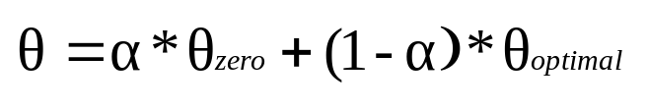

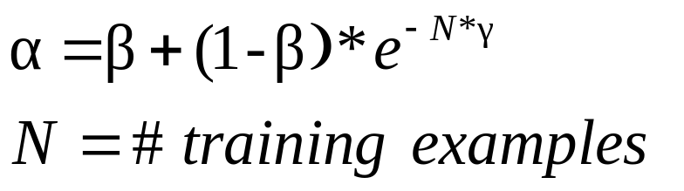
Beta-Gamma Threshold Learning
Encourage exploration
up to θ_{zero}
θ
Utility
α
Cutoff position
0 1 2 3 … K ...
β
γ, N
β,γ ∈[0,1]
The more examples,
the less exploration
(closer to θ_{optimal})

Slide 142
Beta-Gamma Threshold Learning (cont.)
Pros
  Explicitly addresses exploration-exploitation tradeoff (“Safe” exploration)
  Arbitrary utility (with appropriate lower bound)
  Empirically effective
Cons
  Purely heuristic
  Zero utility lower bound often too conservative

Slide 143
2. Collaborative Filtering

Slide 144
What is Collaborative Filtering (CF)?
Making filtering decisions for an individual user based on the judgments of other users
Inferring individual’s interest/preferences from that of other similar users
General idea
  Given a user u, find similar users {u₁, …, u_{m}}
  Predict u’s preferences based on the preferences of u₁, …, u_{m}

Slide 145
CF: Assumptions
Users with a common interest will have similar preferences
Users with similar preferences probably share the same interest
Examples
  “interest is IR” => “favor SIGIR papers”
  “favor SIGIR papers” => “interest is IR”
Sufficiently large number of user preferences are available

Slide 146
CF: Intuitions
User similarity (Kevin Chang vs. Jiawei Han)
  If Kevin liked the paper, Jiawei will like the paper
  ? If Kevin liked the movie, Jiawei will like the movie
  Suppose Kevin and Jiawei viewed similar movies in the past six months …
Item similarity
  Since 90% of those who liked Star Wars also liked Independence Day, and, you liked Star Wars
  You may also like Independence Day
The content of items “didn’t matter”!

Slide 147
The Collaboration Filtering Problem
Ratings
Objects: O
Users: U
o₁ o₂ … o_{j} … o_{n}
3 1.5 …. … 2
₂
₁
₃
X_{ij}=f(u_{i},o_{j})=?
u₁
u₂
…
u_{i}
...
u_{m}
The task
?
Assume known f values for some (u,o)’s
Predict f values for other (u,o)’s
Essentially function approximation, like other learning problems
Unknown function
f: U x O→ R

Slide 148
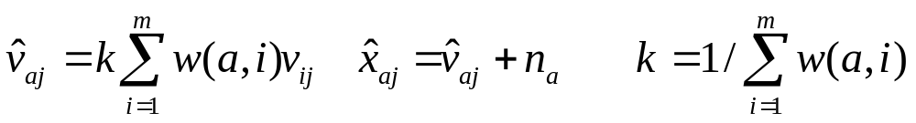
Memory-based Approaches
General ideas:
  X_{ij}: rating of object o_{j} by user u_{i}
  n_{i}: average rating of all objects by user u_{i}
  Normalized ratings: V_{ij} = X_{ij} – n_{i}
  Memory-based prediction of rating of object o_{j} by user u_{a}
Specific approaches differ in w(a,i) -- the distance/similarity between user u_{a} and u_{i}

Slide 149
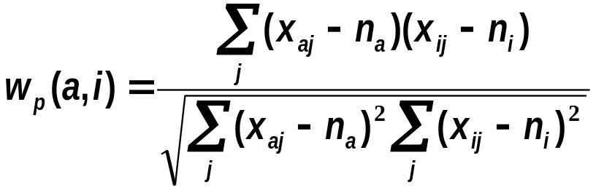
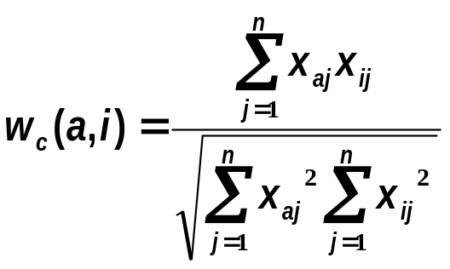
User Similarity Measures
Pearson correlation coefficient (sum over commonly rated items)
Cosine measure
Many other possibilities!

Slide 150
Many Ideas for Further Improvement
Dealing with missing values: set to default ratings (e.g., average ratings), or try to predict missing values
Inverse User Frequency (IUF): similar to IDF
Cluster users and items
Exploit temporal trends
Exploit other information (e.g., user history, text information about items)
…

Slide 151
Tutorial Outline
Part 1: Background
  1.1 Text Information Systems
  1.2 Information Access: Push vs. Pull
  1.3 Querying vs. Browsing
  1.4 Elements of Text Information Systems
Part 2: Information retrieval techniques
  2.1 Overview of IR
  2.2 Retrieval models
  2.3 Evaluation
  2.4 Retrieval systems
  2.5 Information filtering
Part 3: Text mining techniques
  3.1 Overview of text mining
  3.2 IR-style text mining
  3.3 NLP-style text mining
  3.4 ML-style text mining
Part 4: Web search
  4.1 Overview
  4.2 Web search technologies
  4.3 Next-generation search engines
MIAS Tutorial Summer 2012

Slide 152
Part 3.1: Overview of Text Mining
MIAS Tutorial Summer 2012

Slide 153
What is Text Mining?
Data Mining View: Explore patterns in textual data
  Find latent topics
  Find topical trends
  Find outliers and other hidden patterns
Natural Language Processing View: Make inferences based on partial understanding natural language text
  Information extraction
  Question answering
MIAS Tutorial Summer 2012

Slide 154
Applications of Text Mining
Direct applications
  Discovery-driven (Bioinformatics, Business Intelligence, etc): We have specific questions; how can we exploit data mining to answer the questions?
  Data-driven (WWW, literature, email, customer reviews, etc): We have a lot of data; what can we do with it?
Indirect applications
  Assist information access (e.g., discover latent topics to better summarize search results)
  Assist information organization (e.g., discover hidden structures)
MIAS Tutorial Summer 2012

Slide 155
Text Mining Methods
Data Mining Style: View text as high dimensional data
  Frequent pattern finding
  Association analysis
  Outlier detection
Information Retrieval Style: Fine granularity topical analysis
  Topic extraction
  Exploit term weighting and text similarity measures
  Question answering
Natural Language Processing Style: Information Extraction
  Entity extraction
  Relation extraction
  Sentiment analysis
Machine Learning Style: Unsupervised or semi-supervised learning
  Mixture models
  Dimension reduction
MIAS Tutorial Summer 2012

Slide 156
Part 3.2: IR-Style Techniques for Text Mining
MIAS Tutorial Summer 2012

Slide 157
Some “Basic” IR Techniques
Stemming
Stop words
Weighting of terms (e.g., TF-IDF)
Vector/Unigram representation of text
Text similarity (e.g., cosine, KL-div)
Relevance/pseudo feedback (e.g., Rocchio)
They are not just for retrieval!
MIAS Tutorial Summer 2012

Slide 158
Generality of Basic Techniques
t₁ t₂ … t_{n}
t
t
t
Term
similarity
t
t
t
t
d₁
d₂
…
d_{m}
t
w₁₁ w_{12…} w_{1n}
w₂₁ w_{22…} w_{2n}
… …
w_{m1} w_{m2…} w_{mn}
t
t
t
t
CLUSTERING
Doc
similarity
d
d
d
d
d
d
d
d
d
d
d
d
d
Term Weighting
d
Vector
centroid
Sentence
selection
Tokenized text
SUMMARIZATION
d
Stemming & Stop words
META-DATA/
ANNOTATION
Raw text
CATEGORIZATION
MIAS Tutorial Summer 2012

Slide 159
Text Categorization
Pre-given categories and labeled document examples (Categories may form hierarchy)
Classify new documents
A standard supervised learning problem
Sports
Business
Education
Science
Categorization
System
…
…
Sports
Business
Education
MIAS Tutorial Summer 2012

Slide 160
“Retrieval-based” Categorization
Treat each category as representing an “information need”
Treat examples in each category as “relevant documents”
Use feedback approaches to learn a good “query”
Match all the learned queries to a new document
A document gets the category(categories) represented by the best matching query(queries)
MIAS Tutorial Summer 2012

Slide 161
Prototype-based Classifier
Key elements (“retrieval techniques”)
  Prototype/document representation (e.g., term vector)
  Document-prototype distance measure (e.g., dot product)
  Prototype vector learning: Rocchio feedback
Example
MIAS Tutorial Summer 2012

Slide 162
K-Nearest Neighbor Classifier
Keep all training examples
Find k examples that are most similar to the new document (“neighbor” documents)
Assign the category that is most common in these neighbor documents (neighbors vote for the category)
Can be improved by considering the distance of a neighbor ( A closer neighbor has more influence)
Technical elements (“retrieval techniques”)
  Document representation
  Document distance measure
MIAS Tutorial Summer 2012

Slide 163
Example of K-NN Classifier
(k=4)
(k=1)
MIAS Tutorial Summer 2012

Slide 164
The Clustering Problem
Discover “natural structure”
Group similar objects together
Object can be document, term, passages
Example
MIAS Tutorial Summer 2012

Slide 165
Similarity-based Clustering
(as opposed to “model-based”)
Define a similarity function to measure similarity between two objects
Gradually group similar objects together in a bottom-up fashion
Stop when some stopping criterion is met
Variations: different ways to compute group similarity based on individual object similarity
MIAS Tutorial Summer 2012

Slide 166
Similarity-induced Structure
MIAS Tutorial Summer 2012

Slide 167
How to Compute Group Similarity?
Three Popular Methods:
Given two groups g1 and g2,
Single-link algorithm: s(g1,g2)= similarity of the closest pair
complete-link algorithm: s(g1,g2)= similarity of the farthest pair
average-link algorithm: s(g1,g2)= average of similarity of all pairs
MIAS Tutorial Summer 2012

Slide 168
Three Methods Illustrated
complete-link algorithm
g1
g2
?
……
Single-link algorithm
average-link algorithm
MIAS Tutorial Summer 2012

Slide 169
The Summarization Problem
Essentially “semantic compression” of text
Selection-based vs. generation-based summary
In general, we need a purpose for summarization, but it’s hard to define it
MIAS Tutorial Summer 2012

Slide 170
“Retrieval-based” Summarization
Observation: term vector ≈ summary?
Basic approach
  Rank “sentences”, and select top N as a summary
Methods for ranking sentences
  Based on term weights
  Based on position of sentences
  Based on the similarity of sentence and document vector
MIAS Tutorial Summer 2012

Slide 171
Simple Discourse Analysis
vector 1
vector 2
vector 3
…
…
vector n-1
vector n
----------
----------
----------
----------
----------
----------
----------
----------
----------
----------
----------
----------
----------
----------
----------
----------
similarity
similarity
similarity
MIAS Tutorial Summer 2012

Slide 172
A Simple Summarization Method
----------
----------
----------
----------
----------
----------
----------
----------
----------
----------
----------
----------
----------
----------
----------
----------
summary
Most similar
in each segment
sentence 1
sentence 2
sentence 3
Doc vector
MIAS Tutorial Summer 2012

Slide 173
Part 3.3: NLP-Style Text Mining Techniques
Most of the following slides are from William Cohen’s IE tutorial
MIAS Tutorial Summer 2012

Slide 174
What is “Information Extraction”
As a family
of techniques:
Information Extraction =
segmentation + classification + association + clustering
October 14, 2002, 4:00 a.m. PT
For years, Microsoft Corporation CEO Bill Gates railed against the economic philosophy of open-source software with Orwellian fervor, denouncing its communal licensing as a "cancer" that stifled technological innovation.
Today, Microsoft claims to "love" the open-source concept, by which software code is made public to encourage improvement and development by outside programmers. Gates himself says Microsoft will gladly disclose its crown jewels--the coveted code behind the Windows operating system--to select customers.
"We can be open source. We love the concept of shared source," said Bill Veghte, a Microsoft VP. "That's a super-important shift for us in terms of code access.“
Richard Stallman, founder of the Free Software Foundation, countered saying…
*
Microsoft Corporation
CEO
Bill Gates
Microsoft
Gates
Microsoft
Bill Veghte
Microsoft
VP
Richard Stallman
founder
Free Software Foundation
Free Soft..
Microsoft
Microsoft
TITLE ORGANIZATION
*
*
founder
CEO
VP
*
Stallman
Veghte
NAME
Bill Gates
Richard
Bill
MIAS Tutorial Summer 2012

Slide 175
Landscape of IE Tasks:
Complexity
E.g. word patterns:
Closed set
Regular set
U.S. states
U.S. phone numbers
He was born in Alabama…
Phone: (413) 545-1323
The big Wyoming sky…
The CALD main office can be
reached at 412-268-1299
Complex pattern
Ambiguous patterns,
needing context and
many sources of evidence
U.S. postal addresses
University of Arkansas
P.O. Box 140
Hope, AR 71802
Person names
…was among the six houses sold by Hope Feldman that year.
Headquarters:
1128 Main Street, 4th Floor
Cincinnati, Ohio 45210
Pawel Opalinski, Software
Engineer at WhizBang Labs.
MIAS Tutorial Summer 2012
Notes:
How complicated a modeling technique will you have to use?

Slide 176
Landscape of IE Tasks:
Single Field/Record
Jack Welch will retire as CEO of General Electric tomorrow. The top role
at the Connecticut company will be filled by Jeffrey Immelt.
Single entity
Binary relationship
N-ary record
Person: Jack Welch
Relation: Person-Title
Person: Jack Welch
Title: CEO
Relation: Succession
Company: General Electric
Title: CEO
Out: Jack Welsh
In: Jeffrey Immelt
Person: Jeffrey Immelt
Location: Connecticut
Relation: Company-Location
Company: General Electric
Location: Connecticut
“Named entity” extraction
MIAS Tutorial Summer 2012
Notes:
How many components of the output of your system? Single entity…
It is more difficult to get high accuracy on the right than on the left, because each consituent has to be right, and errors compound. 90%^5=60%

Slide 177
Landscape of IE Techniques
Classify Pre-segmented
Candidates
Lexicons
Sliding Window
Abraham Lincoln was born in Kentucky.
Abraham Lincoln was born in Kentucky.
Abraham Lincoln was born in Kentucky.
member?
Classifier
Alabama
Alaska
…
Wisconsin
Wyoming
Classifier
which class?
which class?
Try alternate
window sizes:
Boundary Models
Finite State Machines
Context Free Grammars
Abraham Lincoln was born in Kentucky.
Abraham Lincoln was born in Kentucky.
Abraham Lincoln was born in Kentucky.
BEGIN
Most likely state sequence?
NNP
NNP
V
V
P
NP
Classifier
Most likely parse?
PP
which class?
VP
NP
VP
BEGIN
END
BEGIN
END
S
MIAS Tutorial Summer 2012

Slide 178
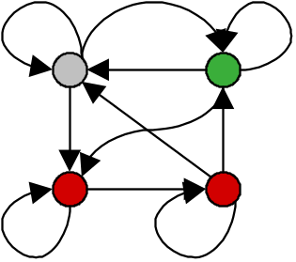

IE with Hidden Markov Models
Given a sequence of observations:
Yesterday Pedro Domingos spoke this example sentence.
and a trained HMM:
person name
location name
background
Find the most likely state sequence: (Viterbi)
Yesterday Pedro Domingos spoke this example sentence.
Any words said to be generated by the designated “person name”
state extract as a person name:
Person name: Pedro Domingos
MIAS Tutorial Summer 2012

Slide 179
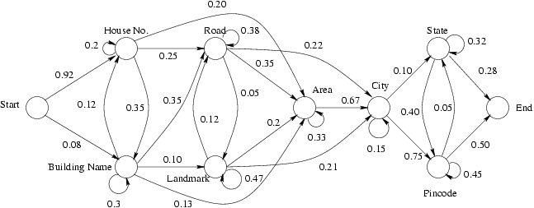
HMM for Segmentation
Simplest Model: One state per entity type
MIAS Tutorial Summer 2012

Slide 180
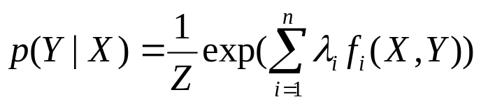
Discriminative Approaches
Yesterday Pedro Domingos spoke this example sentence.
Is this phrase (X) a name? Y=1 (yes); Y=0 (no)
Learn from many examples to predict Y from X
parameters
Maximum Entropy, Logistic Regression:
Features (e.g., is the phrase capitalized?)
More sophisticated: Consider dependency between different labels
(e.g. Conditional Random Fields)
MIAS Tutorial Summer 2012

Slide 181
Part 3.4 Statistical Learning Style Techniques for Text Mining
MIAS Tutorial Summer 2012

Slide 182
Comparative Text Mining (CTM)
Problem definition:
Given a comparable set of text collections
Discover & analyze their common and unique properties
A pool of text Collections
Collection C₁
Collection C₂ ….
Collection C_{k}
Common themes
C₁-
specific
themes
C₂-
specific
themes
C_{k}-
specific
themes
MIAS Tutorial Summer 2012

Slide 183
Example: Summarizing Customer Reviews
IBM Laptop
Reviews
APPLE Laptop
Reviews
DELL Laptop
Reviews
Common Themes | “IBM” specific | “APPLE” specific | “DELL” specific
Battery Life | Long, 4-3 hrs | Medium, 3-2 hrs | Short, 2-1 hrs
Hard disk | Large, 80-100 GB | Small, 5-10 GB | Medium, 20-50 GB
Speed | Slow, 100-200 Mhz | Very Fast, 3-4 Ghz | Moderate, 1-2 Ghz
Ideal results from comparative text mining
MIAS Tutorial Summer 2012

Slide 184
A More Realistic Setup of CTM
IBM Laptop Reviews
APPLE Laptop Reviews
DELL Laptop Reviews
Common Themes | “IBM” specific | “APPLE” specific | “DELL” specific
Battery 0.129 Hours 0.080 Life 0.060 … | Long 0.120 4hours 0.010 3hours 0.008 … | Reasonable 0.10 Medium 0.08 2hours 0.002 … | Short 0.05 Poor 0.01 1hours 0.005 ..
Disk 0.015 IDE 0.010 Drive 0.005 .. | Large 0.100 80GB 0.050 … | Small 0.050 5GB 0.030 ... | Medium 0.123 20GB 0.080 ….
Pentium 0.113 Processor 0.050 … | Slow 0.114 200Mhz 0.080 … | Fast 0.151 3Ghz 0.100 … | Moderate 0.116 1Ghz 0.070 …
Common
Word
Distr.
Collection-specific Word Distributions
MIAS Tutorial Summer 2012

Slide 185
Probabilistic Latent Semantic Analysis/Indexing (PLSA/PLSI) [Hofmann 99]
Mix k multinomial distributions to generate a document
Each document has a potentially different set of mixing weights which captures the topic coverage
When generating words in a document, each word may be generated using a DIFFERENT multinomial distribution
We may add a background distribution to “attract” background words
MIAS Tutorial Summer 2012

Slide 186
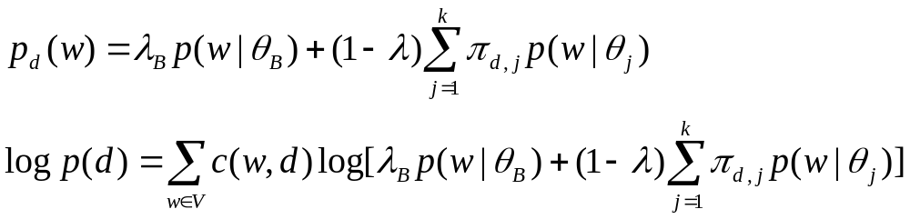
PLSA as a Mixture Model
Document d
warning 0.3 system 0.2..
Theme θ₁
π_{d,1}
θ₁
“Generating” word w
in doc d in the collection
Aid 0.1
donation 0.05
support 0.02 ..
θ₂
Theme θ₂
π_{d,2}
1 - λ_{B}
π_{d, k}
W
…
θ_{k}
statistics 0.2
loss 0.1
dead 0.05 ..
λ_{B}
Theme θ_{k}
B
Is 0.05
the 0.04
a 0.03 ..
Background B
Parameters:
λ_{B}=noise-level (manually set)
θ’s and π’s are estimated with Maximum Likelihood
MIAS Tutorial Summer 2012

Slide 187
Cross-Collection Mixture Models
C₁
C₂
C_{m}
Explicitly distinguish and model common themes and specific themes
Fit a mixture model with the text data
Estimate parameters using EM
Clusters are more meaningful
Background θ_{B}
Theme 1 in common: θ₁
Theme 1
Specific
to C₁
θ_{1,1}
Theme 1
Specific
to C₂
θ_{1,2}
Theme 1
Specific
to C_{m}
θ_{1,m}
…………………
…
Theme k in common: θ_{k}
Theme k
Specific
to C₁
θ_{k,1}
Theme k
Specific
to C₂
θ_{k,2}
Theme k
Specific
to C_{m}
θ_{k,m}
MIAS Tutorial Summer 2012

Slide 188
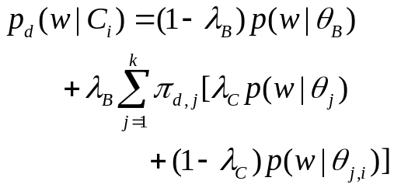
Details of the Mixture Model
Account for noise (common non-informative words)
Background
θ_{B}
Common
Distribution
“Generating” word w
in doc d in collection C_{i}
θ₁
λ_{C}
λ_{B}
Theme 1
θ_{1,i}
1-λ_{C}
W
π_{d,1}
Collection-specific
Distr.
…
1-λ_{B}
π_{d,k}
Common
Distribution
θ_{k}
λ_{C}
Theme k
θ_{k,i}
Parameters:
λ_{B}=noise-level (manually set)
λ_{C}=Common-Specific tradeoff (manually set)
θ’s and π’s are estimated with Maximum Likelihood
1-λ_{C}
Collection-specific
Distr.
MIAS Tutorial Summer 2012

Slide 189
Comparing News Articles
Iraq War (30 articles) vs. Afghan War (26 articles)
The common theme indicates that “United Nations” is involved in both wars
 | Cluster 1 | Cluster 2 | Cluster 3
Common Theme | united 0.042 nations 0.04 … | killed 0.035 month 0.032 deaths 0.023 … | …
Iraq Theme | n 0.03 Weapons 0.024 Inspections 0.023 … | troops 0.016 hoon 0.015 sanches 0.012 … | …
Afghan Theme | Northern 0.04 alliance 0.04 kabul 0.03 taleban 0.025 aid 0.02 … | taleban 0.026 rumsfeld 0.02 hotel 0.012 front 0.011 … | …
Collection-specific themes indicate different roles of “United Nations” in the two wars
MIAS Tutorial Summer 2012

Slide 190
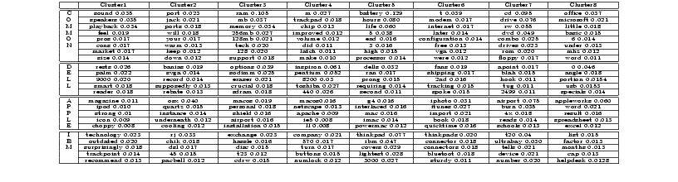
Comparing Laptop Reviews
Top words serve as “labels” for common themes
(e.g., [sound, speakers], [battery, hours], [cd,drive])
These word distributions can be used to segment text and
add hyperlinks between documents
MIAS Tutorial Summer 2012

Slide 191
Additional Results of
Contextual Text Mining
Spatiotemporal topic pattern analysis
Theme evolution analysis
Event impact analysis
Sentiment summarization
All results are from Qiaozhu Mei’s dissertation, available at:
http://www.ideals.illinois.edu/handle/2142/14707
MIAS Tutorial Summer 2012

Slide 192
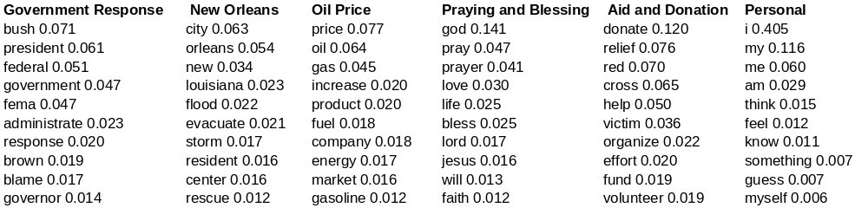
Spatiotemporal Patterns in Blog Articles
Query= “Hurricane Katrina”
Topics in the results:
Spatiotemporal patterns
MIAS Tutorial Summer 2012

Slide 193
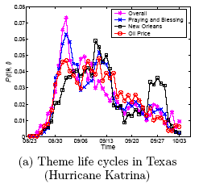

Theme Life Cycles (“Hurricane Katrina”)
Oil Price
price 0.0772
oil 0.0643
gas 0.0454
increase 0.0210
product 0.0203
fuel 0.0188
company 0.0182
…
New Orleans
city 0.0634
orleans 0.0541
new 0.0342
louisiana 0.0235
flood 0.0227
evacuate 0.0211
storm 0.0177
…
MIAS Tutorial Summer 2012
Notes:
The upper figure is the life cycles for different themes in Texas. The red line refers to a theme with the top probability words such as price, oil, gas, increase, etc, from which we know that it is talking about “oil price”. The blue one, on the other hand, talks about events that happened in the city “new orleans”. In the upper figure, we can see that both themes were getting hot during the first two weeks, and became weaker around the mid September. The theme New Orleans got strong again around the last week of September while the other theme dropped monotonically.
In the bottom figure, which is the life cycles for the same theme “New Orleans” in different states. We observe that this theme reaches
the highest probability first in Florida and Louisiana, followed by Washington and Texas, consecutively. During early September, this theme drops significantly in Louisiana while still strong in other states. We suppose this is because of the evacuation in Louisiana. Surprisingly, around late September, a re-arising pattern can be observed in most states, which is most significant in Louisiana. Since this is the time period in which Hurricane Rita arrived, we guess that Hurricane Rita has an impact on the discussion of Hurricane Katrina. This is reasonable since people
are likely to mention the two hurricanes together or make comparisons. We can find more clues to this hypothesis from Hurricane Rita data set.

Slide 194


Theme Snapshots (“Hurricane Katrina”)
Week2: The discussion moves towards the north and west
Week1: The theme is the strongest along the Gulf of Mexico
Week3: The theme distributes more uniformly over the states
Week4: The theme is again strong along the east coast and the Gulf of Mexico
Week5: The theme fades out in most states
MIAS Tutorial Summer 2012
Notes:
This slide shows the snapshot for theme ``Government Response'' over the first five weeks of Hurricane Katrina. The darker the color is, the hotter the discussion about this theme is. we observe that at the first week of Hurricane Katrina, the theme ``Government Response'‘ is the strongest in the southeast states, especially those along the Gulf of Mexico. In week 2, we can see the pattern that the theme is spreading towards the north and western states because the northern states are getting darker. In week 3, the theme is distributed even more uniformly, which means that it is spreading all over the states. However, in week 4, we observe that the theme converges to east states and southeast coast again. Interestingly, this week happens to overlap with the first week of Hurricane Rita, which may raise the public concern about government response again in those areas. In week 5, the theme becomes weak in most inland states and most of the remaining discussions are along the coasts.
Another interesting observation is that this theme is originally very strong in Louisiana (the one to the right of Texas, ), but dramatically weakened in Louisiana during week 2 and 3, and becomes strong again from the fourth week. Interestingly, Week 2 and 3 are consistent with the time of evacuation in Louisiana.

Slide 195

Theme Life Cycles (KDD Papers)
gene 0.0173
expressions 0.0096
probability 0.0081
microarray 0.0038
…
marketing 0.0087
customer 0.0086
model 0.0079
business 0.0048
…
rules 0.0142
association 0.0064
support 0.0053
…
MIAS Tutorial Summer 2012

Slide 196
Theme Evolution Graph: KDD
1999
2000
2001
2002
2003
2004
T
web 0.009
classifica –tion 0.007
features0.006
topic 0.005
…
SVM 0.007
criteria 0.007
classifica – tion 0.006
linear 0.005
…
mixture 0.005
random 0.006
cluster 0.006
clustering 0.005
variables 0.005
…
topic 0.010
mixture 0.008
LDA 0.006
semantic
0.005
…
decision 0.006
tree 0.006
classifier 0.005
class 0.005
Bayes 0.005
…
…
Classifica
- tion 0.015
text 0.013
unlabeled 0.012
document 0.008
labeled 0.008
learning 0.007
…
Informa
- tion 0.012
web 0.010
social 0.008
retrieval 0.007
distance 0.005
networks 0.004
…
…
…
…
MIAS Tutorial Summer 2012

Slide 197
Aspect Sentiment Summarization
Query: “Da Vinci Code”
 | Neutral | Positive | Negative
Topic 1: Movie | ... Ron Howards selection of Tom Hanks to play Robert Langdon. | Tom Hanks stars in the movie,who can be mad at that? | But the movie might get delayed, and even killed off if he loses.
 | Directed by: Ron Howard Writing credits: Akiva Goldsman ... | Tom Hanks, who is my favorite movie star act the leading role. | protesting ... will lose your faith by watching the movie.
 | After watching the movie I went online and some research on ... | Anybody is interested in it? | ... so sick of people making such a big deal about a FICTION book and movie.
Topic 2: Book | I remembered when i first read the book, I finished the book in two days. | Awesome book. | ... so sick of people making such a big deal about a FICTION book and movie.
 | I’m reading “Da Vinci Code” now. … | So still a good book to past time. | This controversy book cause lots conflict in west society.
MIAS Tutorial Summer 2012

Slide 198


Separate Theme Sentiment Dynamics
“book”
“religious beliefs”
MIAS Tutorial Summer 2012

Slide 199
Event Impact Analysis: IR Research
xml 0.0678
email 0.0197
model 0.0191
collect 0.0187
judgment 0.0102
rank 0.0097
subtopic 0.0079
…
vector 0.0514
concept 0.0298
extend 0.0297
model 0.0291
space 0.0236
boolean 0.0151
function 0.0123
feedback 0.0077
…
Theme: retrieval models
SIGIR papers
term 0.1599
relevance 0.0752
weight 0.0660
feedback 0.0372
independence 0.0311
model 0.0310
frequent 0.0233
probabilistic 0.0188
document 0.0173
…
Publication of the paper “A language modeling approach to information retrieval”
1992
year
1998
Starting of the TREC conferences
model 0.1687
language 0.0753
estimate 0.0520
parameter 0.0281
distribution 0.0268
probable 0.0205
smooth 0.0198
markov 0.0137
likelihood 0.0059
…
probabilist 0.0778
model 0.0432
logic 0.0404
ir 0.0338
boolean 0.0281
algebra 0.0200
estimate 0.0119
weight 0.0111
…
MIAS Tutorial Summer 2012

Slide 200
Topic Evoluation Graph (KDD Papers)
1999
2000
2001
2002
2003
2004
T
KDD
web 0.009
classification
0.007
features0.006
topic 0.005
…
SVM 0.007
criteria 0.007
classifica – tion 0.006
linear 0.005
…
mixture 0.005
random 0.006
cluster 0.006
clustering 0.005
variables 0.005
…
topic 0.010
mixture 0.008
LDA 0.006
semantic
0.005
…
decision 0.006
tree 0.006
classifier 0.005
class 0.005
Bayes 0.005
…
…
classification
0.015
text 0.013
unlabeled 0.012
document 0.008
labeled 0.008
learning 0.007
…
information
0.012
web 0.010
social 0.008
retrieval 0.007
distance 0.005
networks 0.004
…
…
…
MIAS Tutorial Summer 2012

Slide 201
Tutorial Outline
Part 1: Background
  1.1 Text Information Systems
  1.2 Information Access: Push vs. Pull
  1.3 Querying vs. Browsing
  1.4 Elements of Text Information Systems
Part 2: Information retrieval techniques
  2.1 Overview of IR
  2.2 Retrieval models
  2.3 Evaluation
  2.4 Retrieval systems
  2.5 Information filtering
Part 3: Text mining techniques
  3.1 Overview of text mining
  3.2 IR-style text mining
  3.3 NLP-style text mining
  3.4 ML-style text mining
Part 4: Web search
  4.1 Overview
  4.2 Web search technologies
  4.3 Next-generation search engines
MIAS Tutorial Summer 2012

Slide 202
Part 4.1 Overview of Web Search
MIAS Tutorial Summer 2012

Slide 203
Web Search: Challenges & Opportunities
Challenges
  Scalability
    How to handle the size of the Web and ensure completeness of coverage?
    How to serve many user queries quickly?
  Low quality information and spams
  Dynamics of the Web
    New pages are constantly created and some pages may be updated very quickly
Opportunities
  many additional heuristics (especially links) can be leveraged to improve search accuracy
➔ Parallel indexing & searching (MapReduce)
Spam detection
& robust ranking
Link analysis
MIAS Tutorial Summer 2012

Slide 204
Basic Search Engine Technologies
User
…
Browser
Web
Query
Host Info.
Results
Efficiency!!!
Retriever
Precision
Crawler
Coverage
Freshness
----
----
…
----
----
…
----
----
…
----
----
Indexer
Cached
pages
Error/spam handling
(Inverted) Index
MIAS Tutorial Summer 2012

Slide 205
Part 4.2 Web Search Technologies
MIAS Tutorial Summer 2012

Slide 206
Component I: Crawler/Spider/Robot
Building a “toy crawler” is easy
  Start with a set of “seed pages” in a priority queue
  Fetch pages from the web
  Parse fetched pages for hyperlinks; add them to the queue
  Follow the hyperlinks in the queue
A real crawler is much more complicated…
  Robustness (server failure, trap, etc.)
  Crawling courtesy (server load balance, robot exclusion, etc.)
  Handling file types (images, PDF files, etc.)
  URL extensions (cgi script, internal references, etc.)
  Recognize redundant pages (identical and duplicates)
  Discover “hidden” URLs (e.g., truncating a long URL )
Crawling strategy is an open research topic (i.e., which page to visit next?)
MIAS Tutorial Summer 2012

Slide 207
Major Crawling Strategies
Breadth-First is common (balance server load)
Parallel crawling is natural
Variation: focused crawling
  Targeting at a subset of pages (e.g., all pages about “automobiles” )
  Typically given a query
How to find new pages (easier if they are linked to an old page, but what if they aren’t?)
Incremental/repeated crawling (need to minimize resource overhead)
  Can learn from the past experience (updated daily vs. monthly)
  It’s more important to keep frequently accessed pages fresh
MIAS Tutorial Summer 2012

Slide 208
Component II: Indexer
Standard IR techniques are the basis
  Make basic indexing decisions (stop words, stemming, numbers, special symbols)
  Build inverted index
  Updating
However, traditional indexing techniques are insufficient
  A complete inverted index won’t fit to any single machine!
  How to scale up?
Google’s contributions:
  Google file system: distributed file system
  Big Table: column-based database
  MapReduce: Software framework for parallel computation
  Hadoop: Open source implementation of MapReduce (used in Yahoo!)
MIAS Tutorial Summer 2012

Slide 209

Google’s Basic Solutions
URL
Queue/List
Cached source pages
(compressed)
Inverted index
Use many
features,
e.g. font,
layout,…
Hypertext
structure
MIAS Tutorial Summer 2012

Slide 210
Google’s Contributions
Distributed File System (GFS)
Column-based Database (Big Table)
Parallel programming framework (MapReduce)
MIAS Tutorial Summer 2012

Slide 211
Google File System: Overview
Motivation: Input data is large (whole Web, billions of pages), can’t be stored on one machine
Why not use the existing file systems?
  Network File System (NFS) has many deficiencies ( network congestion, single-point failure)
  Google’s problems are different from anyone else
GFS is designed for Google apps and workloads.
  GFS demonstrates how to support large scale processing workloads on commodity hardware
  Designed to tolerate frequent component failures.
  Optimized for huge files that are mostly appended and read.
  Go for simple solutions.
MIAS Tutorial Summer 2012

Slide 212

GFS Architecture
Simple centralized management
Fixed chunk size (64 MB)
Chunk is replicated
to ensure reliability
Data transfer is directly
between application and
chunk servers
MIAS Tutorial Summer 2012

Slide 213
MapReduce
Provide easy but general model for programmers to use cluster resources
Hide network communication (i.e. Remote Procedure Calls)
Hide storage details, file chunks are automatically distributed and replicated
Provide transparent fault tolerance (Failed tasks are automatically rescheduled on live nodes)
High throughput and automatic load balancing (E.g. scheduling tasks on nodes that already have data)
This slide and the following slides about MapReduce are from Behm & Shah’s presentation
http://www.ics.uci.edu/~abehm/class_reports/uci/2008-Spring_CS224/Behm-Shah_PageRank.ppt
MIAS Tutorial Summer 2012

Slide 214
MapReduce Flow
Split Input into Key-Value pairs.
Input
=
Key, Value
Key, Value
…
Map
Map
Map
For each K-V pair call Map.
Key, Value
Key, Value
Key, Value
Each Map produces new set of K-V pairs.
Key, Value
Key, Value
Key, Value
…
…
…
For each distinct key, call reduce. Produces one K-V pair for each distinct key.
Sort
Reduce(K, V[ ])
Output as a set of Key Value Pairs.
Output
=
Key, Value
Key, Value
…
MIAS Tutorial Summer 2012

Slide 215
MapReduce WordCount Example
Input:
File containing words
Output:
Number of occurrences
of each word
Hello World Bye World
Hello Hadoop Bye Hadoop
Bye Hadoop Hello Hadoop
MapReduce
Bye 3
Hadoop 4
Hello 3
World 2
How can we do this within the MapReduce framework?
Basic idea: parallelize on lines in input file!
MIAS Tutorial Summer 2012

Slide 216
MapReduce WordCount Example
Input
1, “Hello World Bye World”
2, “Hello Hadoop Bye Hadoop”
3, “Bye Hadoop Hello Hadoop”
Map Output
<Hello,1>
<World,1>
<Bye,1>
<World,1>
<Hello,1>
<Hadoop,1>
<Bye,1>
<Hadoop,1>
<Bye,1>
<Hadoop,1>
<Hello,1>
<Hadoop,1>
Map
Map(K, V) {
For each word w in V
Collect(w, 1);
}
Map
Map
MIAS Tutorial Summer 2012

Slide 217
MapReduce WordCount Example
Reduce(K, V[ ]) {
Int count = 0;
For each v in V
count += v;
Collect(K, count);
}
Map Output
<Hello,1>
<World,1>
<Bye,1>
<World,1>
<Hello,1>
<Hadoop,1>
<Bye,1>
<Hadoop,1>
<Bye,1>
<Hadoop,1>
<Hello,1>
<Hadoop,1>
Internal Grouping
<Bye → 1, 1, 1>
<Hadoop → 1, 1, 1, 1>
<Hello → 1, 1, 1>
<World → 1, 1>
Reduce
Reduce
Reduce Output
<Bye, 3>
<Hadoop, 4>
<Hello, 3>
<World, 2>
Reduce
Reduce
MIAS Tutorial Summer 2012

Slide 218
Inverted Indexing with MapReduce
D1: java resource java class
D2: java travel resource D3: …
Key Value
java (D1, 2)
resource (D1, 1)
class (D1,1)
Key Value
java (D2, 1)
travel (D2,1)
resource (D2,1)
Map
Built-In Shuffle and Sort: aggregate values by keys
Key Value
java {(D1,2), (D2, 1)}
resource {(D1, 1), (D2,1)}
class {(D1,1)}
travel {(D2,1)}
…
Reduce
Slide adapted from Jimmy Lin’s presentation
MIAS Tutorial Summer 2012

Slide 219

Inverted Indexing: Pseudo-Code
Slide adapted from Jimmy Lin’s presentation
MIAS Tutorial Summer 2012

Slide 220
Process Many Queries in Real Time
MapReduce not useful for query processing, but other parallel processing strategies can be adopted
Main ideas
  Partitioning (for scalability): doc-based vs. term-based
  Replication (for redundancy)
  Caching (for speed)
  Routing (for load balancing)
MIAS Tutorial Summer 2012

Slide 221

Open Source Toolkit: Katta
(Distributed Lucene)
http://katta.sourceforge.net/
MIAS Tutorial Summer 2012

Slide 222
Component III: Retriever
Standard IR models apply but aren’t sufficient
  Different information need (navigational vs. informational queries)
  Documents have additional information (hyperlinks, markups, URL)
  Information quality varies a lot
  Server-side traditional relevance/pseudo feedback is often not feasible due to complexity
Major extensions
  Exploiting links (anchor text, link-based scoring)
  Exploiting layout/markups (font, title field, etc.)
  Massive implicit feedback (opportunity for applying machine learning)
  Spelling correction
  Spam filtering
In general, rely on machine learning to combine all kinds of features
MIAS Tutorial Summer 2012

Slide 223
Exploiting Inter-Document Links
“Extra text”/summary for a doc
Description
(“anchor text”)
Links indicate the utility of a doc
Hub
What does a link tell us?
Authority
MIAS Tutorial Summer 2012

Slide 224
PageRank: Capturing Page “Popularity”
Intuitions
  Links are like citations in literature
  A page that is cited often can be expected to be more useful in general
PageRank is essentially “citation counting”, but improves over simple counting
  Consider “indirect citations” (being cited by a highly cited paper counts a lot…)
  Smoothing of citations (every page is assumed to have a non-zero citation count)
PageRank can also be interpreted as random surfing (thus capturing popularity)
MIAS Tutorial Summer 2012

Slide 225





The PageRank Algorithm
Random surfing model: At any page,
With prob. α, randomly jumping to another page
With prob. (1-α), randomly picking a link to follow.
p(di): PageRank score of di = average probability of visiting page di
d₁
Transition matrix
Mij = probability of going
from di to dj
d₃
d₂
d₄
probability of visiting page dj at time t+1
probability of at page di at time t
“Equilibrium Equation”:
N= # pages
Reach dj via random jumping
Reach dj via following a link
dropping the time index
I_{ij} = 1/N
We can solve the equation with an iterative algorithm
MIAS Tutorial Summer 2012

Slide 226


PageRank: Example
d₁
d₃
d₂
d₄
Initial value p(d)=1/N,
iterate until converge
Do you see how scores are propagated over the graph?
MIAS Tutorial Summer 2012

Slide 227
PageRank in Practice
Computation can be quite efficient since M is usually sparse
Interpretation of the damping factor α (≈0.15):
  Probability of a random jump
  Smoothing the transition matrix (avoid zero’s)
Normalization doesn’t affect ranking, leading to some variants of the formula
The zero-outlink problem: p(di)’s don’t sum to 1
  One possible solution = page-specific damping factor (α=1.0 for a page with no outlink)
Many extensions (e.g., topic-specific PageRank)
Many other applications (e.g., social network analysis)
MIAS Tutorial Summer 2012

Slide 228
HITS: Capturing Authorities & Hubs
Intuitions
  Pages that are widely cited are good authorities
  Pages that cite many other pages are good hubs
The key idea of HITS (Hypertext-Induced Topic Search)
  Good authorities are cited by good hubs
  Good hubs point to good authorities
  Iterative reinforcement…
Many applications in graph/network analysis
MIAS Tutorial Summer 2012

Slide 229


The HITS Algorithm
d₁
“Adjacency matrix”
d₃
Initial values: a(d_{i})=h(d_{i})=1
d₂
d₄
Iterate
Normalize:
MIAS Tutorial Summer 2012

Slide 230
Effective Web Retrieval Heuristics
High accuracy in home page finding can be achieved by
  Matching query with the title
  Matching query with the anchor text
  Plus URL-based or link-based scoring (e.g. PageRank)
Imposing a conjunctive (“and”) interpretation of the query is often appropriate
  Queries are generally very short (all words are necessary)
  The size of the Web makes it likely that at least a page would match all the query words
Combine multiple features using machine learning
MIAS Tutorial Summer 2012

Slide 231
How can we combine many features? (Learning to Rank)
General idea:
  Given a query-doc pair (Q,D), define various kinds of features Xi(Q,D)
  Examples of feature: the number of overlapping terms, BM25 score of Q and D, p(Q|D), PageRank of D, p(Q|Di), where Di may be anchor text or big font text, “does the URL contain ‘~’?”….
  Hypothesize p(R=1|Q,D)=s(X1(Q,D),…,Xn(Q,D), λ) where λ is a set of parameters
  Learn λ by fitting function s with training data, i.e., 3-tuples like (D, Q, 1) (D is relevant to Q) or (D,Q,0) (D is non-relevant to Q)
MIAS Tutorial Summer 2012

Slide 232



Regression-Based Approaches
Logistic Regression: Xi(Q,D) is feature; β’s are parameters
Estimate β’s by maximizing the likelihood of training data
X1(Q,D) X2 (Q,D) X3(Q,D)
BM25 PageRank BM25Anchor
D1 (R=1) 0.7 0.11 0.65
D2 (R=0) 0.3 0.05 0.4
Once β’s are known, we can take Xi(Q,D) computed based on a new query and a new document to generate a score for D w.r.t. Q.
MIAS Tutorial Summer 2012

Slide 233
Machine Learning Approaches:
Pros & Cons
Advantages
  A principled and general way to combine multiple features (helps improve accuracy and combat web spams)
  May re-use all the past relevance judgments (self-improving)
Problems
  Performance mostly depends on the effectiveness of the features used
  No much guidance on feature generation (rely on traditional retrieval models)
In practice, they are adopted in all current Web search engines (with many other ranking applications also)
MIAS Tutorial Summer 2012

Slide 234
Part 4.3 Next-Generation
Web Search Engines
MIAS Tutorial Summer 2012

Slide 235
Next Generation Search Engines
More specialized/customized (vertical search engines)
  Special group of users (community engines, e.g., Citeseer)
  Personalized (better understanding of users)
  Special genre/domain (better understanding of documents)
Learning over time (evolving)
Integration of search, navigation, and recommendation/filtering (full-fledged information management)
Beyond search to support tasks (e.g., shopping)
Many opportunities for innovations!
MIAS Tutorial Summer 2012

Slide 236



The Data-User-Service (DUS) Triangle
Lawyers
Scientists
UIUC employees
Online shoppers
…
Users
Data
Search
Browsing
Mining
Task support, …
Web pages
News articles
Blog articles
Literature
Email
…
Services
MIAS Tutorial Summer 2012

Slide 237
Millions of Ways to
Connect the DUS Triangle!
…
UIUC
Employees
Customer
Service
People
Everyone
Scientists
Online
Shoppers
Web pages
Web Search
Literature
Assistant
Literature
Organization docs
Enterprise
Search
Opinion
Advisor
Blog articles
Customer
Rel. Man.
Product reviews
…
Customer emails
Task/Decision
support
…
Search
Browsing
Alert
Mining
MIAS Tutorial Summer 2012

Slide 238
Future Intelligent Information Systems
Task Support
Full-Fledged Text
Info. Management
Mining
Access
Search
Current Search Engine
Keyword Queries
Bag of words
Search History
Entities-Relations
Personalization
(User Modeling)
Large-Scale
Semantic Analysis
(Vertical Search Engines)
Complete User Model
Knowledge
Representation
MIAS Tutorial Summer 2012

Slide 239
Check out cs410 website http://times.cs.uiuc.edu/course/410s12/ for assignments and additional lectures
MIAS Tutorial Summer 2012

